Slide 1
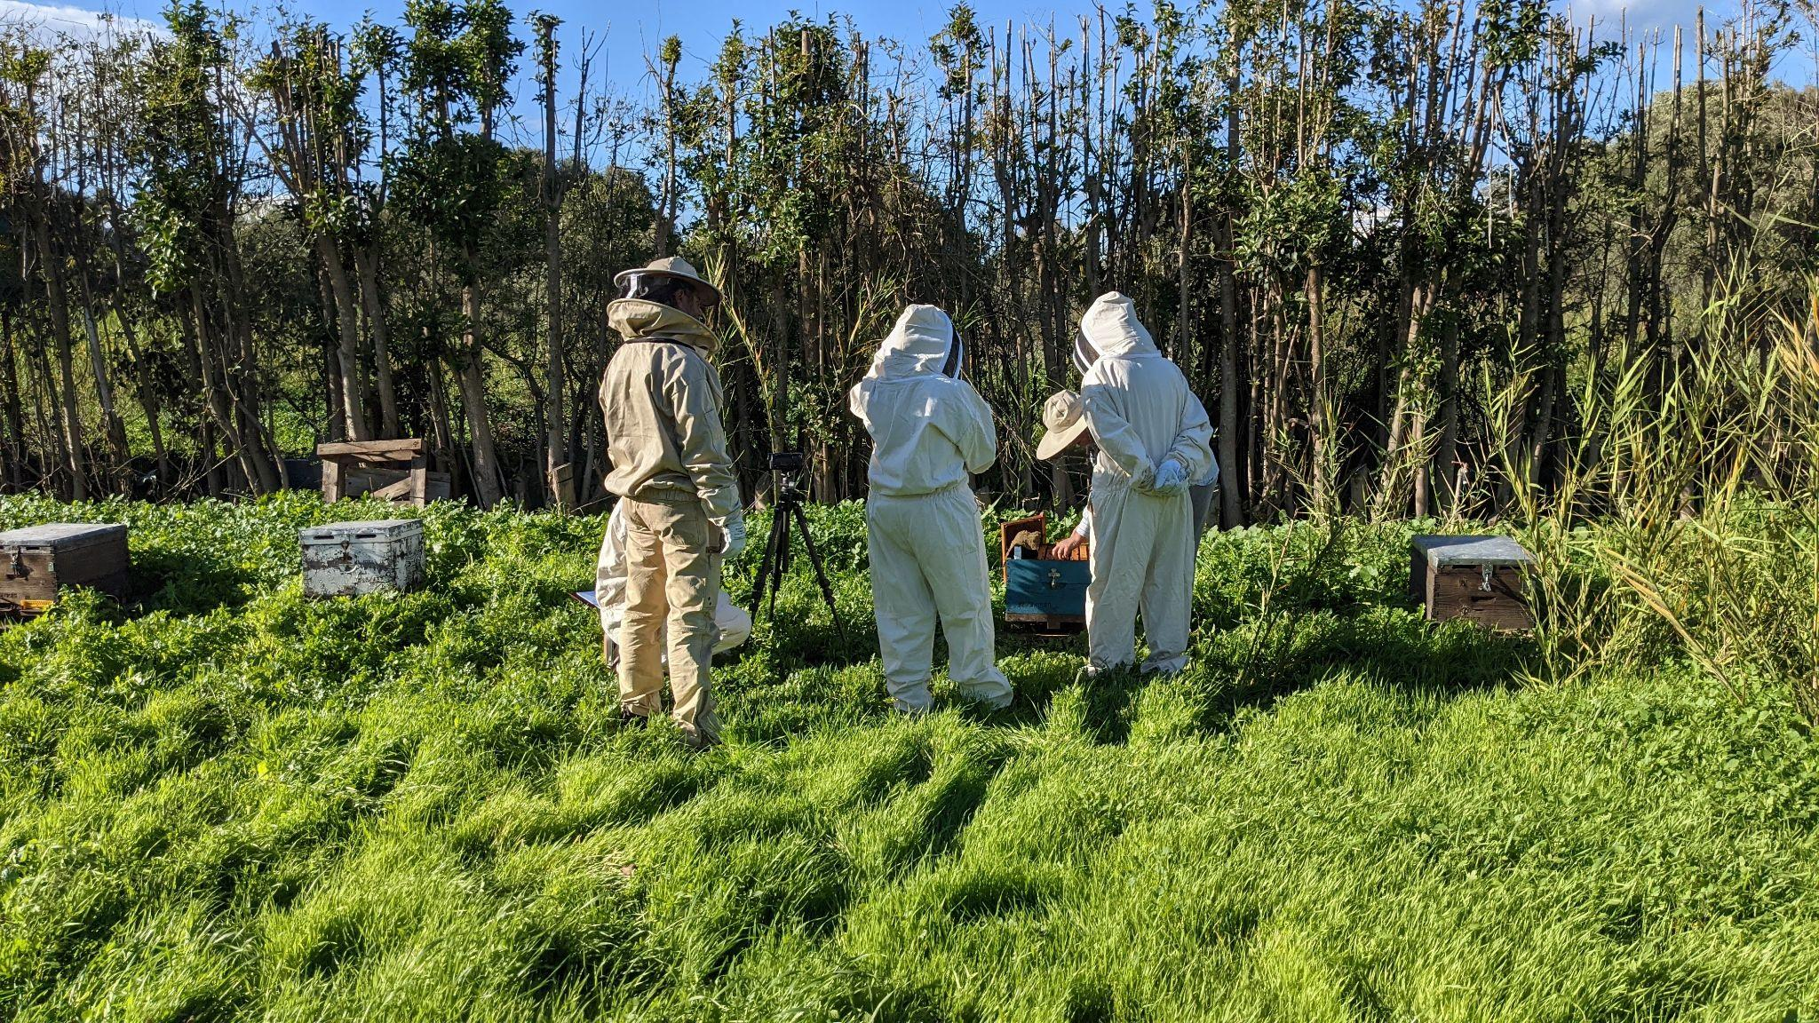
IOHIVE: Interactive Journal for Beekeepers to Support Apiary Inspections
Theodora Chamaidi, Presenter - Katerina Malisova - Vangelis Nomikos - Vangelis Vlachogiannis - Charalambos Alifieris - Chrysostomos Rigakis - Modestos Stavrakis
University of the Aegean -
Department of Product and Systems Design Engineering

Slide 2
Why non-traditional interfaces?
Objectives of the project
Design design and development of technological infrastructures and services for:
Create a natural link with the users` working environment
Promote user performance in multitasking contexts
Focus on the relation of the user and the technology
Remote hive monitoring of beekeeping data
Supporting beekeeping practices and management techniques
Supporting the utilization of all beekeeping products

Slide 3
Beekeeping
Journaling
A labor-intensive practice
Field Visit: Hive inspection
Record observations
Understanding the state of the hive
Understanding the effectiveness of actions
Empirical methods
Notes based on signs, symbols, and numbers
During or after the process of the inspection
Difficult to track the plurality and complexity of data
Our contribution
Install digital sensors on a beehive to assist in collecting data that can be later used to study the health and behavior + provide a journaling assisting device

Slide 4
Logging and Journaling Apiculture Practices
There are certain lists and categories of information that one might look for in an inspection
The amount of data produced in only one inspection can be overwhelming
Beekeepers started journaling those inspections = keep notes
Appearing problems:
1
2
3
Not conducive environment
the quality and quantity of the information differ
Time-consuming

Slide 5
Relatable Systems and Software
Beehive Journaling
Beehive Monitoring
Services and Applications:
Beep App and Beep Scale
OSBeehives and BuzzBox
Data related to:
Temperature
Humidity
Weight
Audio
Video
Vibrations

Slide 6
Design and Development
of infrastructure systems
Evaluation
Methodology
Contextual research
Design and Development
of common systems services
User Research

Slide 7
Record beekeeping practices, the work environment, the challenges beekeepers face and the tools they use
User research
What we learned:
Beekeepers only record a general review of their observations
Problematic situations are preferred to be solved on the spot
Time management and action plan before the next inspection
What other Researchers say:
Not a user-friendly digital tool available
Available systems do not cover their needs
Some parameters stay neglected

Slide 8
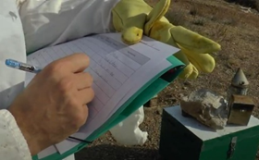
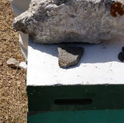
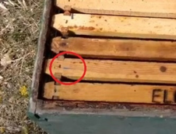
Record beekeeping practices, the work environment, the challenges beekeepers face and the tools they use
User research
Journaling during Inspection
Marks on field
Symbols on the frames

Slide 9
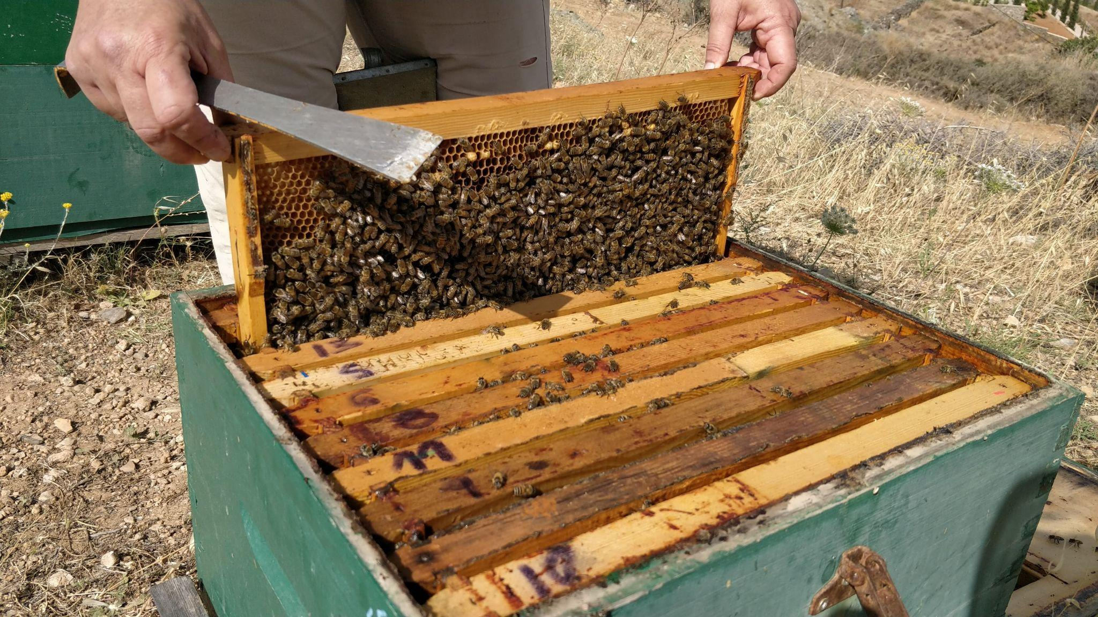
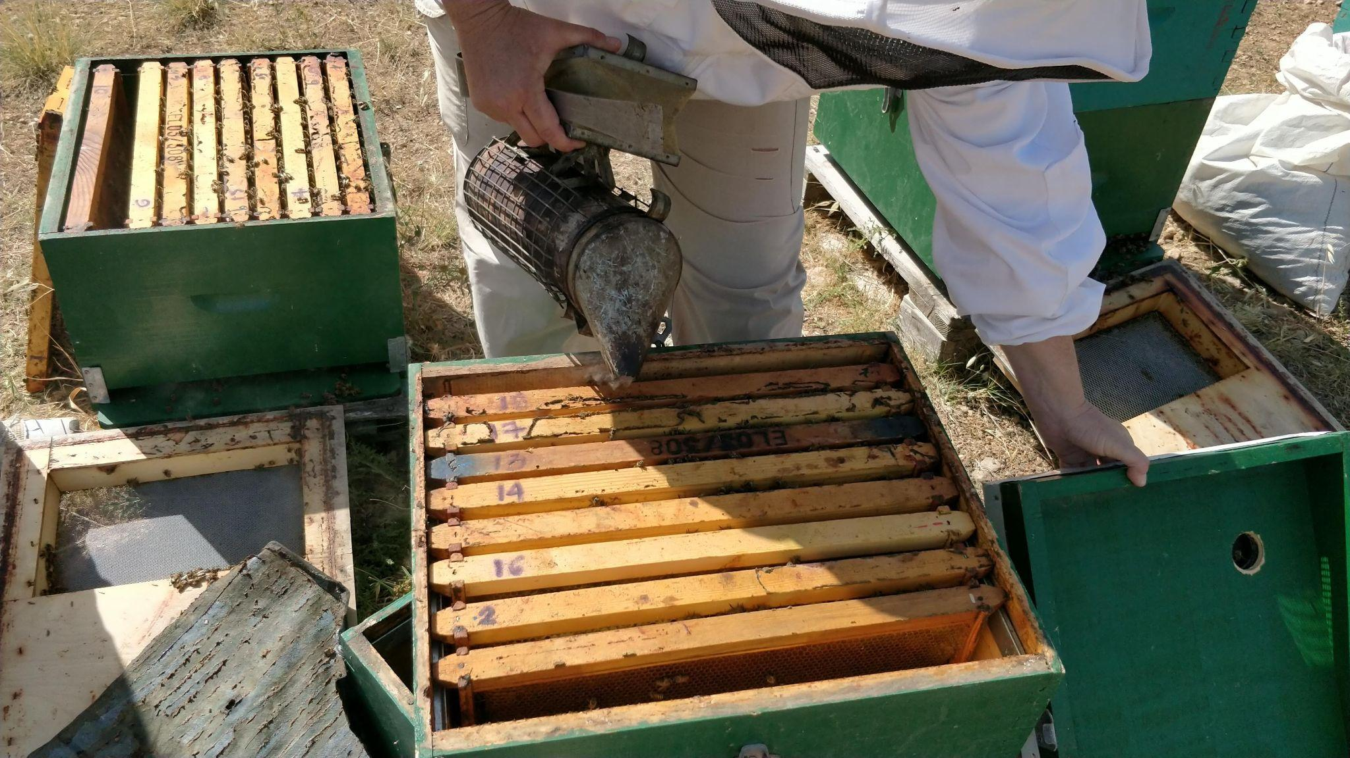
Record beekeeping practices, the work environment, the challenges beekeepers face and the tools they use
User research
Hive tool always on hand
Everything placed at a close range

Slide 10
Interaction Requirements
Hands-free interactive tools
Avoid barehand interactions
Use smart emerging technologies
Portability
Small and Lightweight assistive technology
Utilization of tangible, speech recognition and/or gesture-based interactions

Slide 11
small electronic gadgets with wireless communication capability, which are usually worn on the human body, or easily integrated into accessories and clothing
Wearables
Creation of a digitized version of Journaling
Formation of a new user experience in beekeeping inspection
Functions that meet the needs of beekeepers
Abundance and variety of interactions
Immediate access to charts of live data
Available technologies for manual data input

Slide 12
IOHIVE Platform
Accessible through wearable/tangible device & web application
Integration of different end devices in order to monitor beehives
Devices operated over the LoRa low-power wide-area network modulation technique

Slide 13
Future work of IOHIVE
Design the physical product, the electronics, and the interaction techniques
Develop the web interfaces, the user roles, and the visualization mechanisms
Currently working on…
Conceptual
Designs
Prototypes
Evaluation
Protocols

Slide 14
IOHIVE: Interactive Journal for Beekeepers to Support Apiary Inspections

