Slide 1
IOHIVE: Designing Interactive Systems for Sustainable Beekeeping
IOHIVE Team
FOSSCOMM - Lamia,
November 20, 2022

Slide 2
About us
Department of Product & Systems Design Engineering
Interactive Systems Design Lab / IOHIVE team
What we do
Design and Develop Interactive Digital Systems and Services for the Support and Horizontal Monitoring of Agri-Food Practices with focus on Sustainable Beekeeping

Slide 3
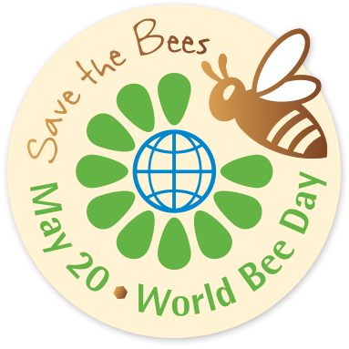
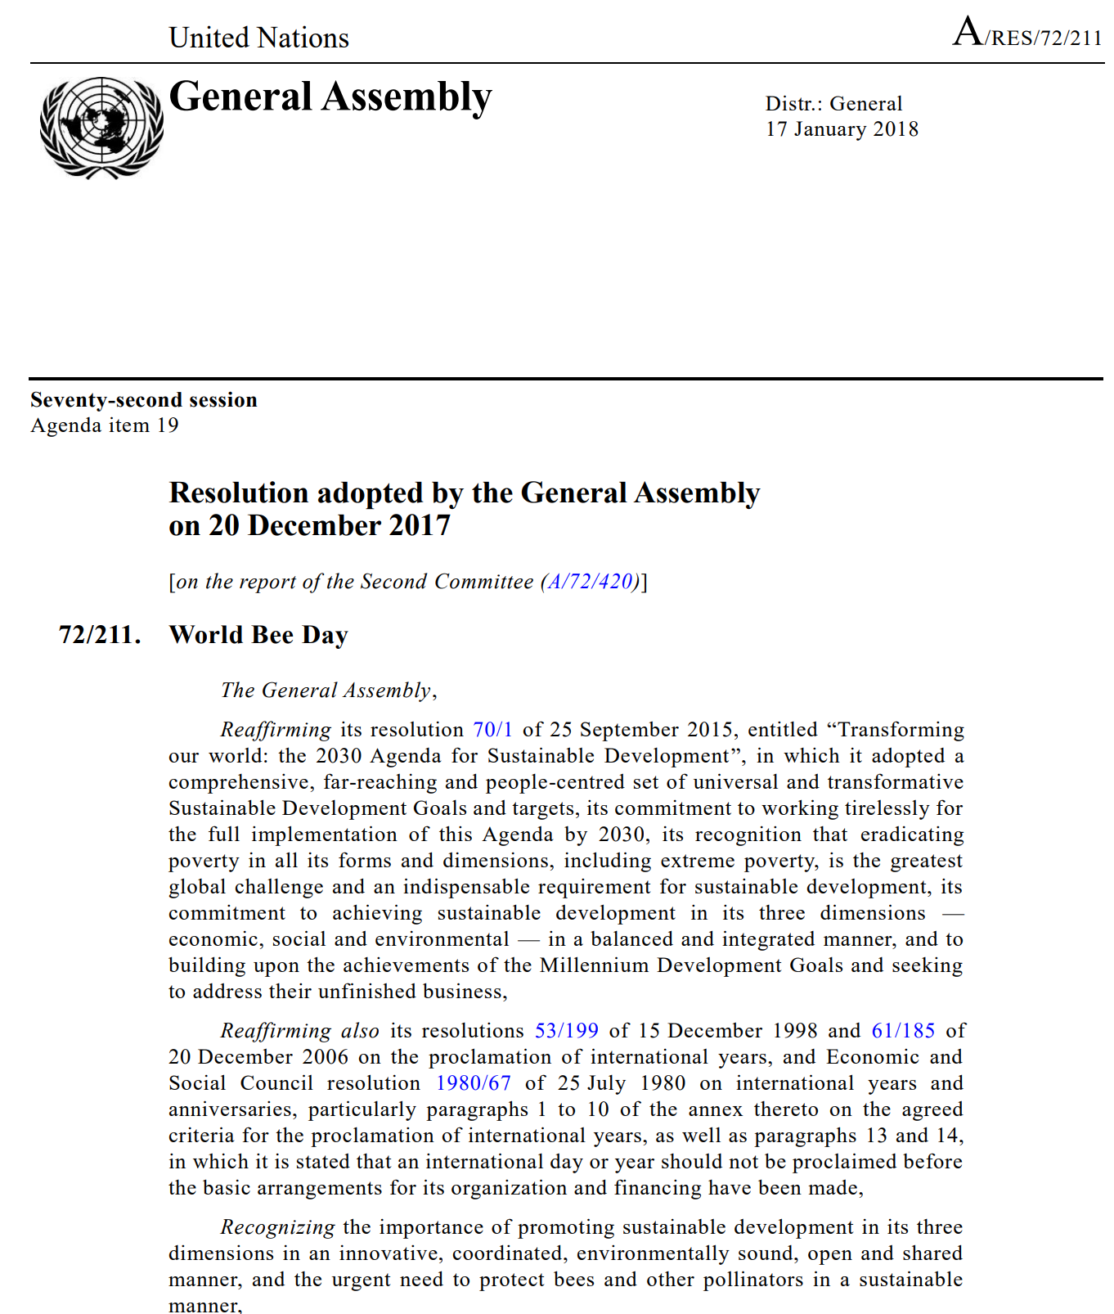
May 20, 2022
World Bee Day
Beekeeping is a widespread and global activity, with millions of beekeepers depending on bees for their livelihoods and well-being. Together with wild pollinators, bees play a major role in maintaining biodiversity, ensuring the survival and reproduction of many plants.
To raise awareness of the importance of pollinators, the threats they face and their contribution to sustainable development, the UN designated 20 May as World Bee Day.
We all depend on pollinators and it is, therefore, crucial to monitor their decline and halt the loss of biodiversity.
Source: https://bit.ly/3PAJRiz

Slide 4
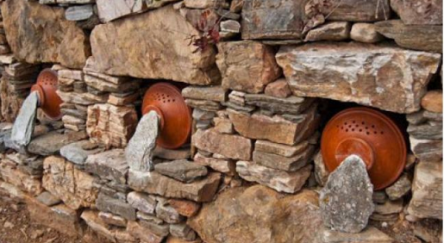
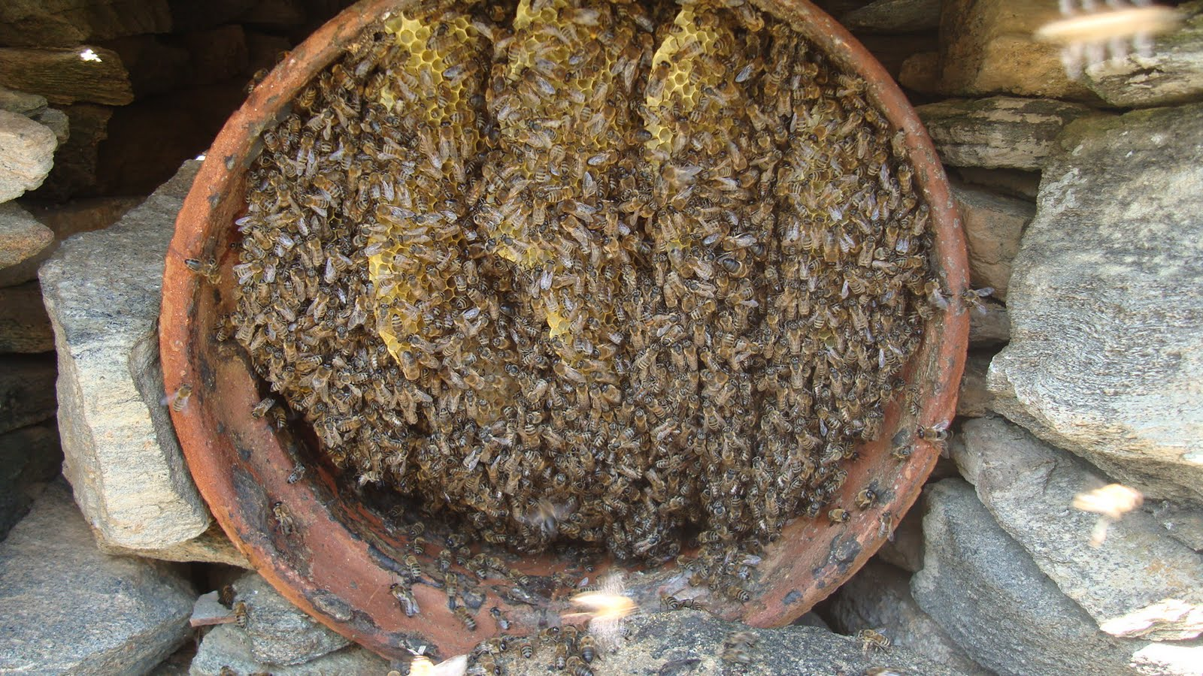
Beekeeping and Cultural Heritage
Beekeeping is not just a profession
An activity with long history and traditional expressions
The prevalence of skills, knowledge and good practice passed down from generation to generation
Each place had its own unique identity
List of the Intangible Cultural Heritage of Humanity

Slide 5
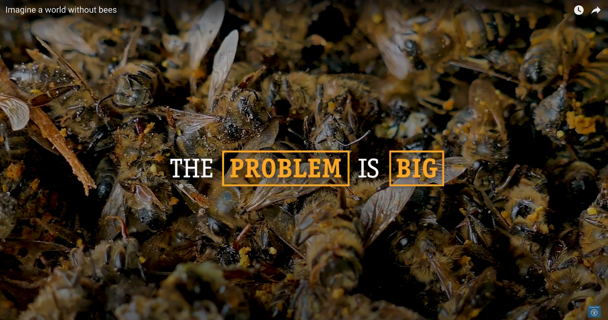
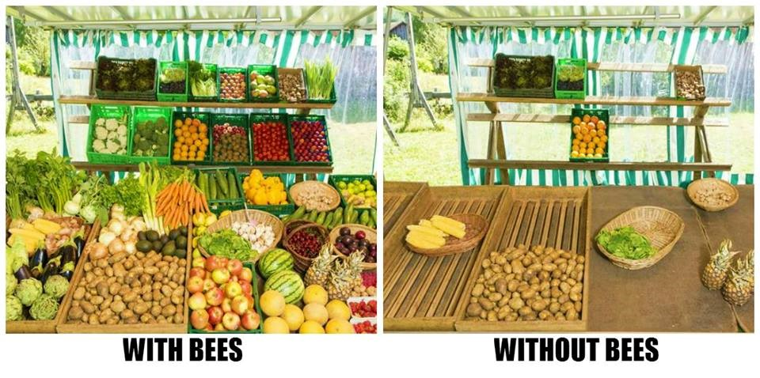
Beekeeping and Climate Change
Bees are under threat. The bee population is constantly decreasing
Human activities such as
changes in land use
intensive agricultural practices and the use of pesticides
pollution
Pests / diseases (Colony Collapse Disorder, Varroa)
It's not just about the honey
Ensuring the world's food security

Slide 6
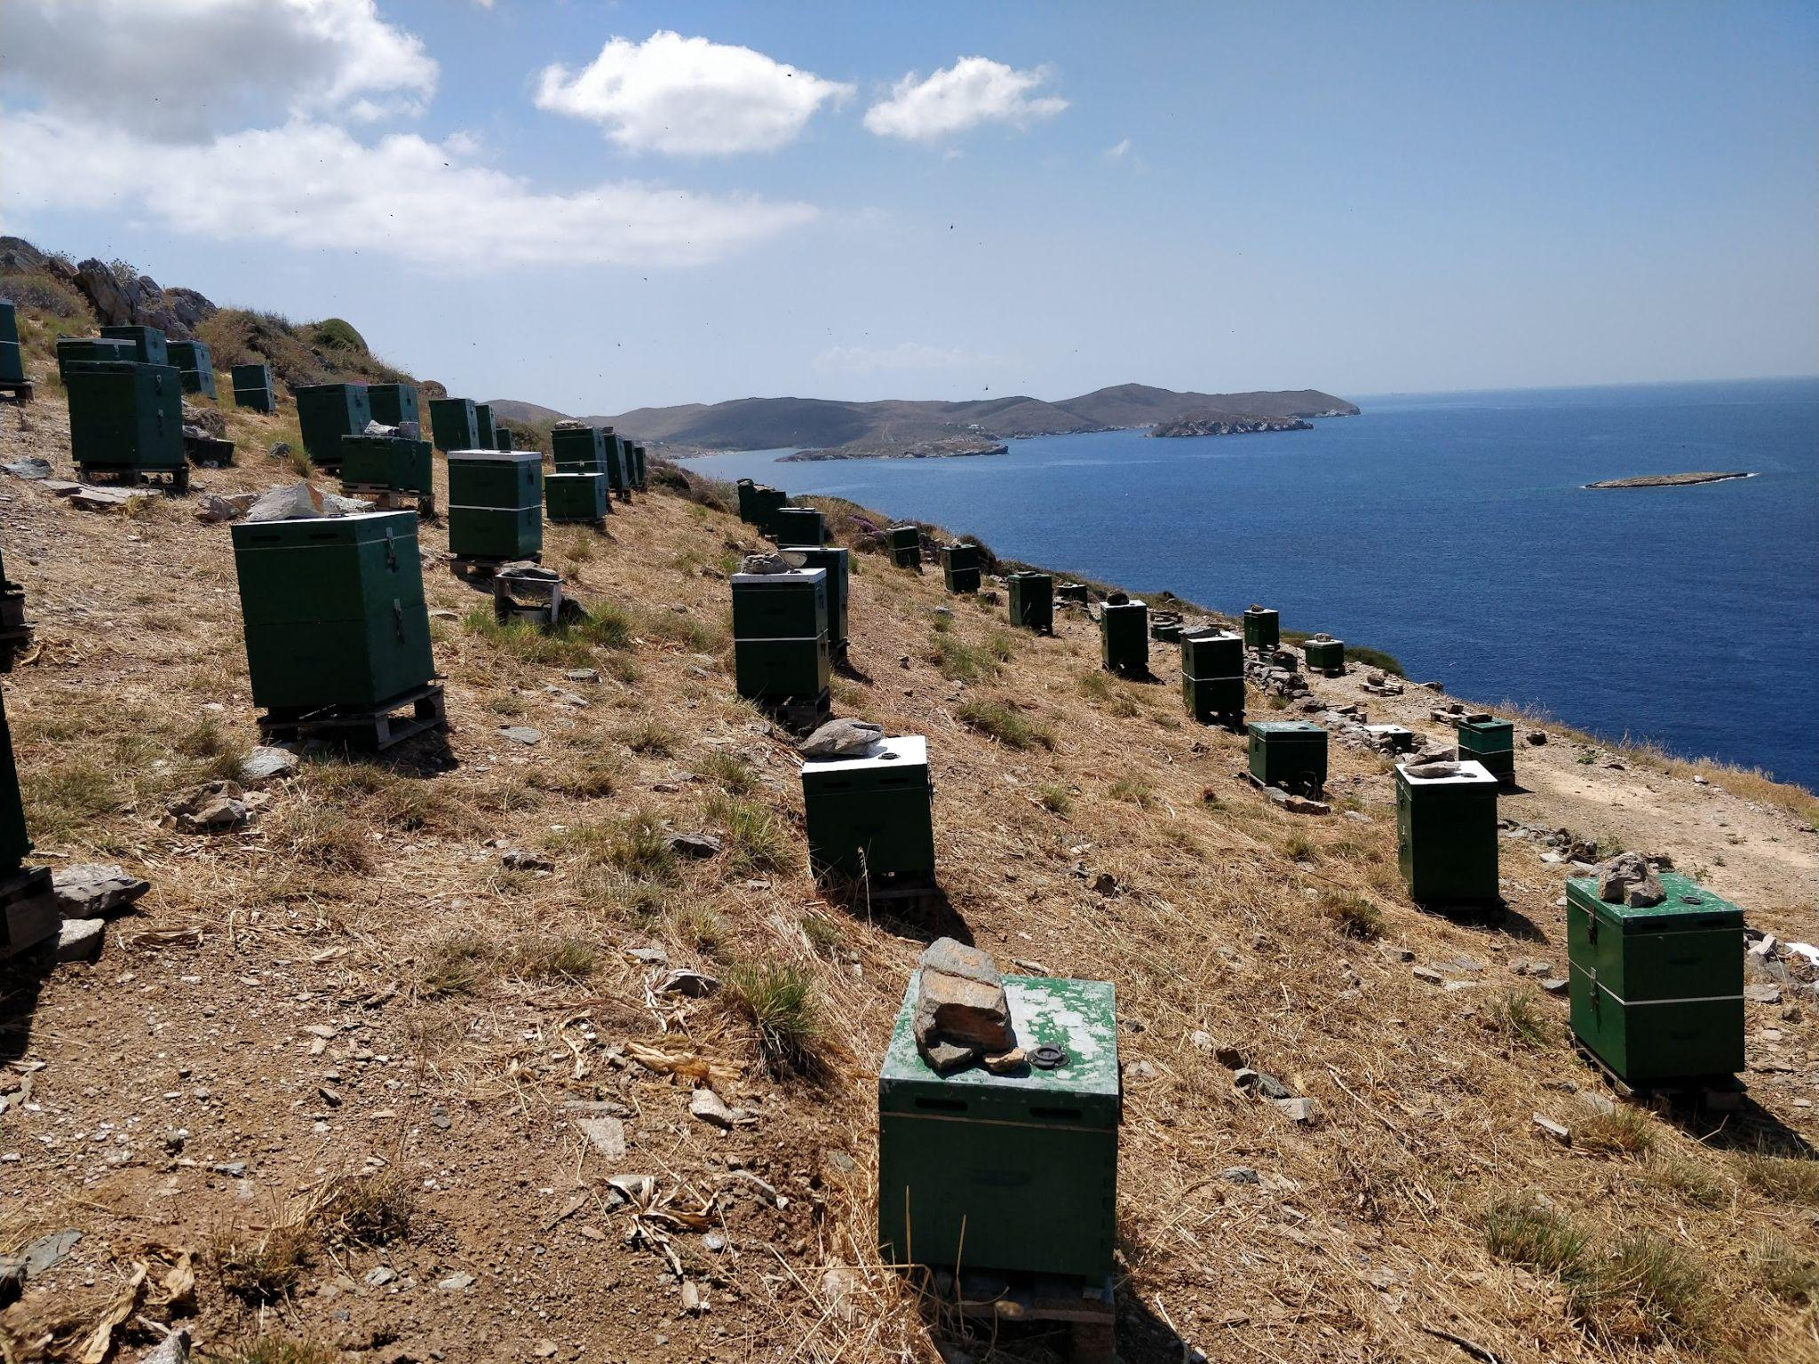
Beekeeping in the Cyclades: The challenge
Special environmental conditions
Large variety of aromatic plants
High quality products (e.g. thyme honey)
Small production but high value
No nomadic beekeeping
Times of drought
Tourism is a threat

Slide 7
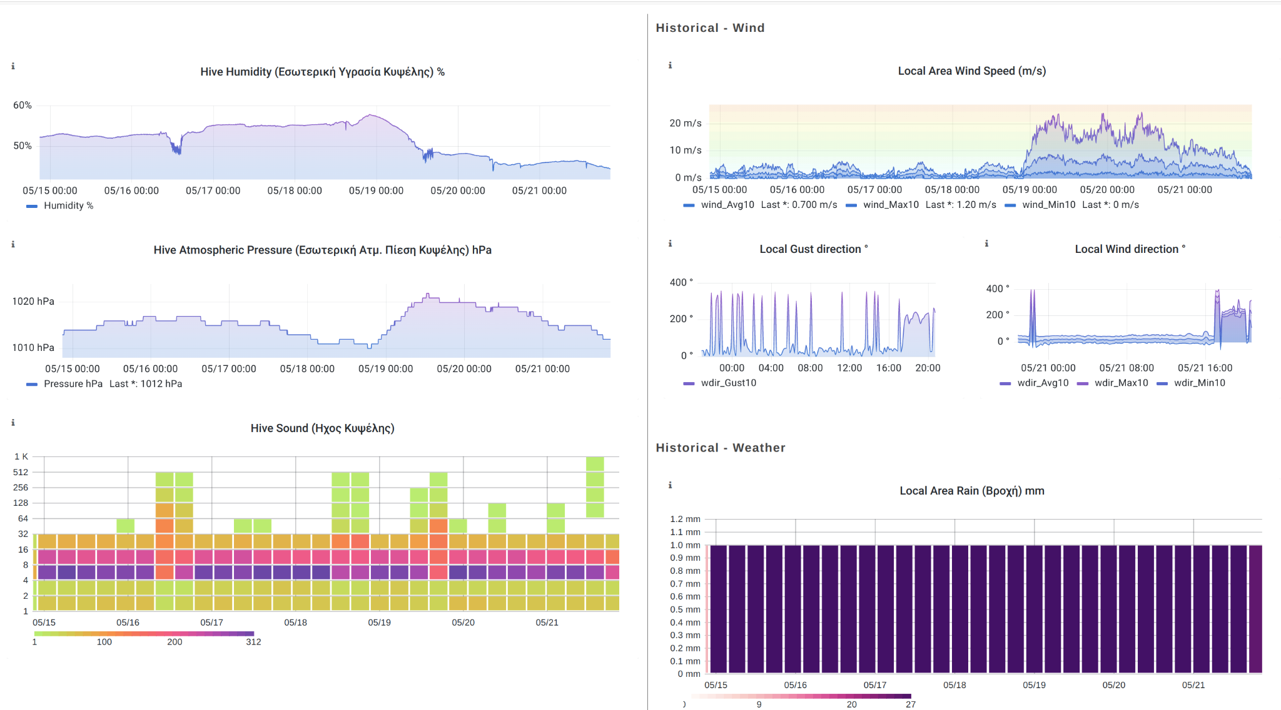
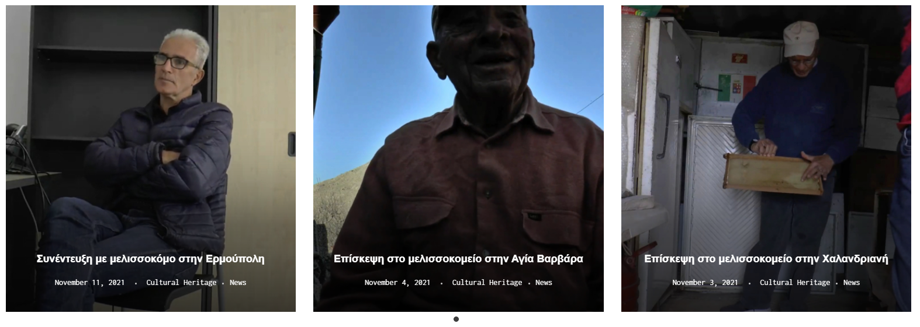
MyHive: Interactive platform for the adoption of bee hives
A new approach to beekeeping and tourism
Raising awareness
Give value to local producers
Roles
Beekeeper (monitor data / manage adoptions / schedule tours)
Adopter (learn / inspect / grab your honey)
Content creator (articles, interviews, blog)

Slide 8
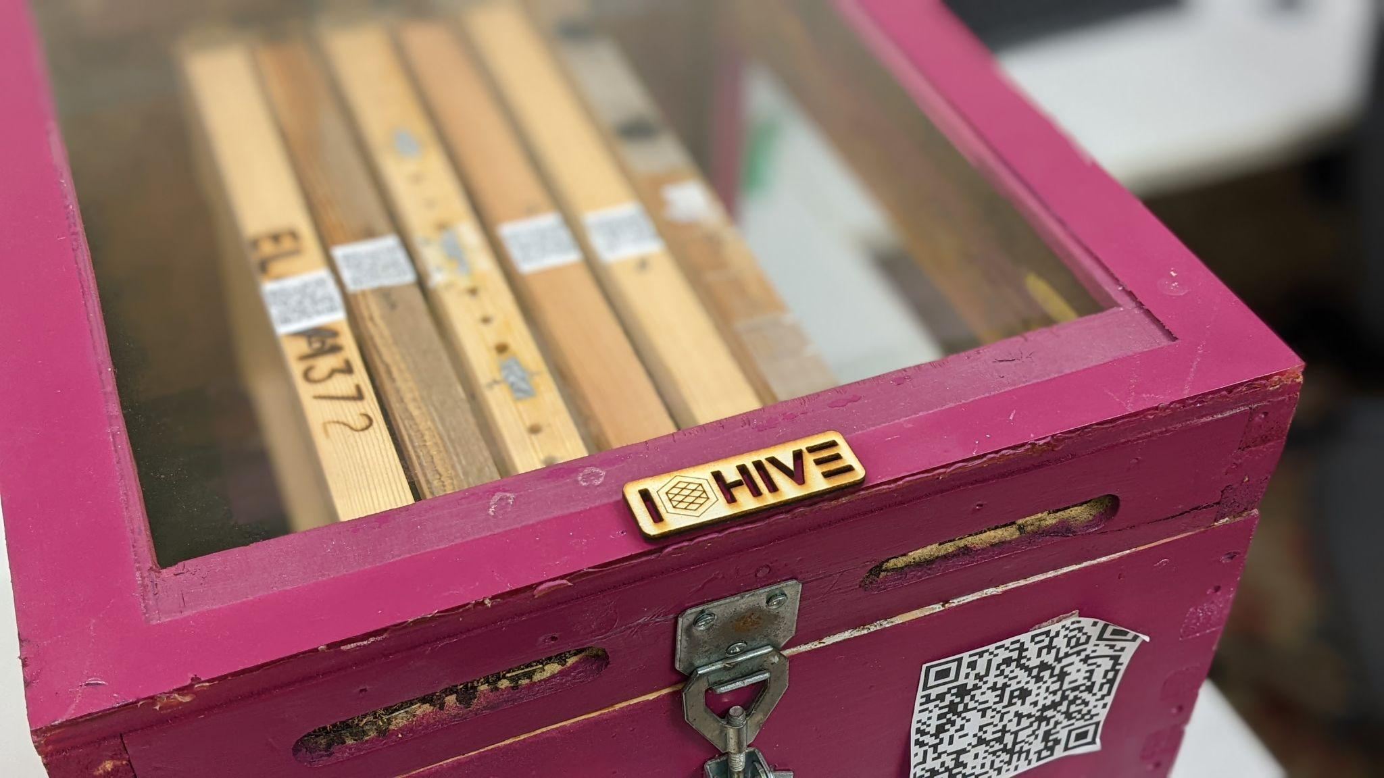
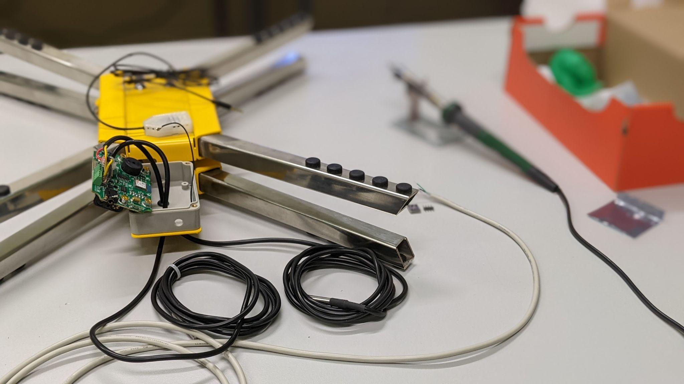
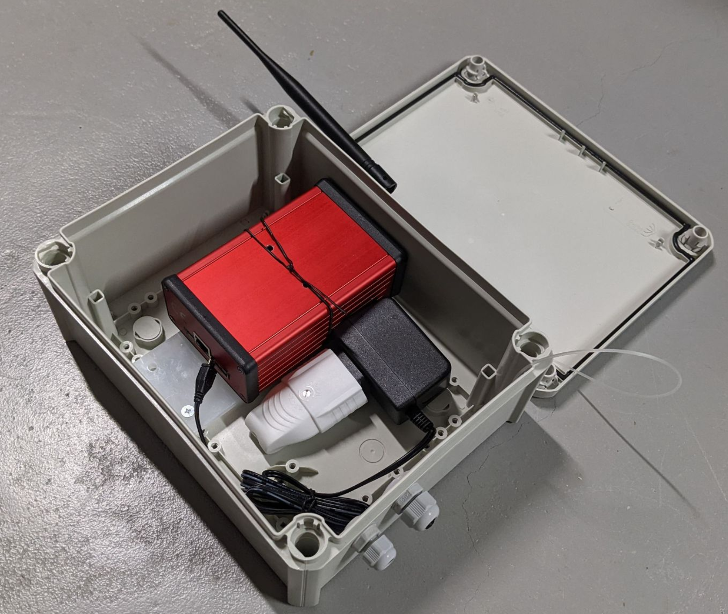
IOHIVE: Internet of Interactive Hives
Hive monitoring with autonomous sensors based on IoT solutions
Application of LoRaWAN technology in Precision Beekeeping
Data visualization and analytics
Interactive Systems for Journaling of Beekeeping Activities based on Tangible and Wearable Interface

Slide 9
The idea
LoRaWAN Network
Core Services
Sensors
Weather Stations
THE THINGS NETWORK

Slide 10
IOHIVE: Partners
ΠΑΝΕΠΙΣΤΗΜΙΟ ΑΙΓΑΙΟΥ
Μηχανικών Σχεδίασης Προϊόντων και Συστημάτων
Εργαστήριο Σχεδίασης Διαδραστικών Συστημάτων
www.syros.aegean.gr
ΕΛΓΟ ΔΗΜΗΤΡΑ
Ινστιτούτο Μεσογειακών και Δασικών Οικοσυστημάτων
Εργαστήριο Μελισσοκομίας
www.fria.gr
KUDZU Ι.Κ.Ε.
IOT Software & Hardware
www.kudzu.gr

Slide 11
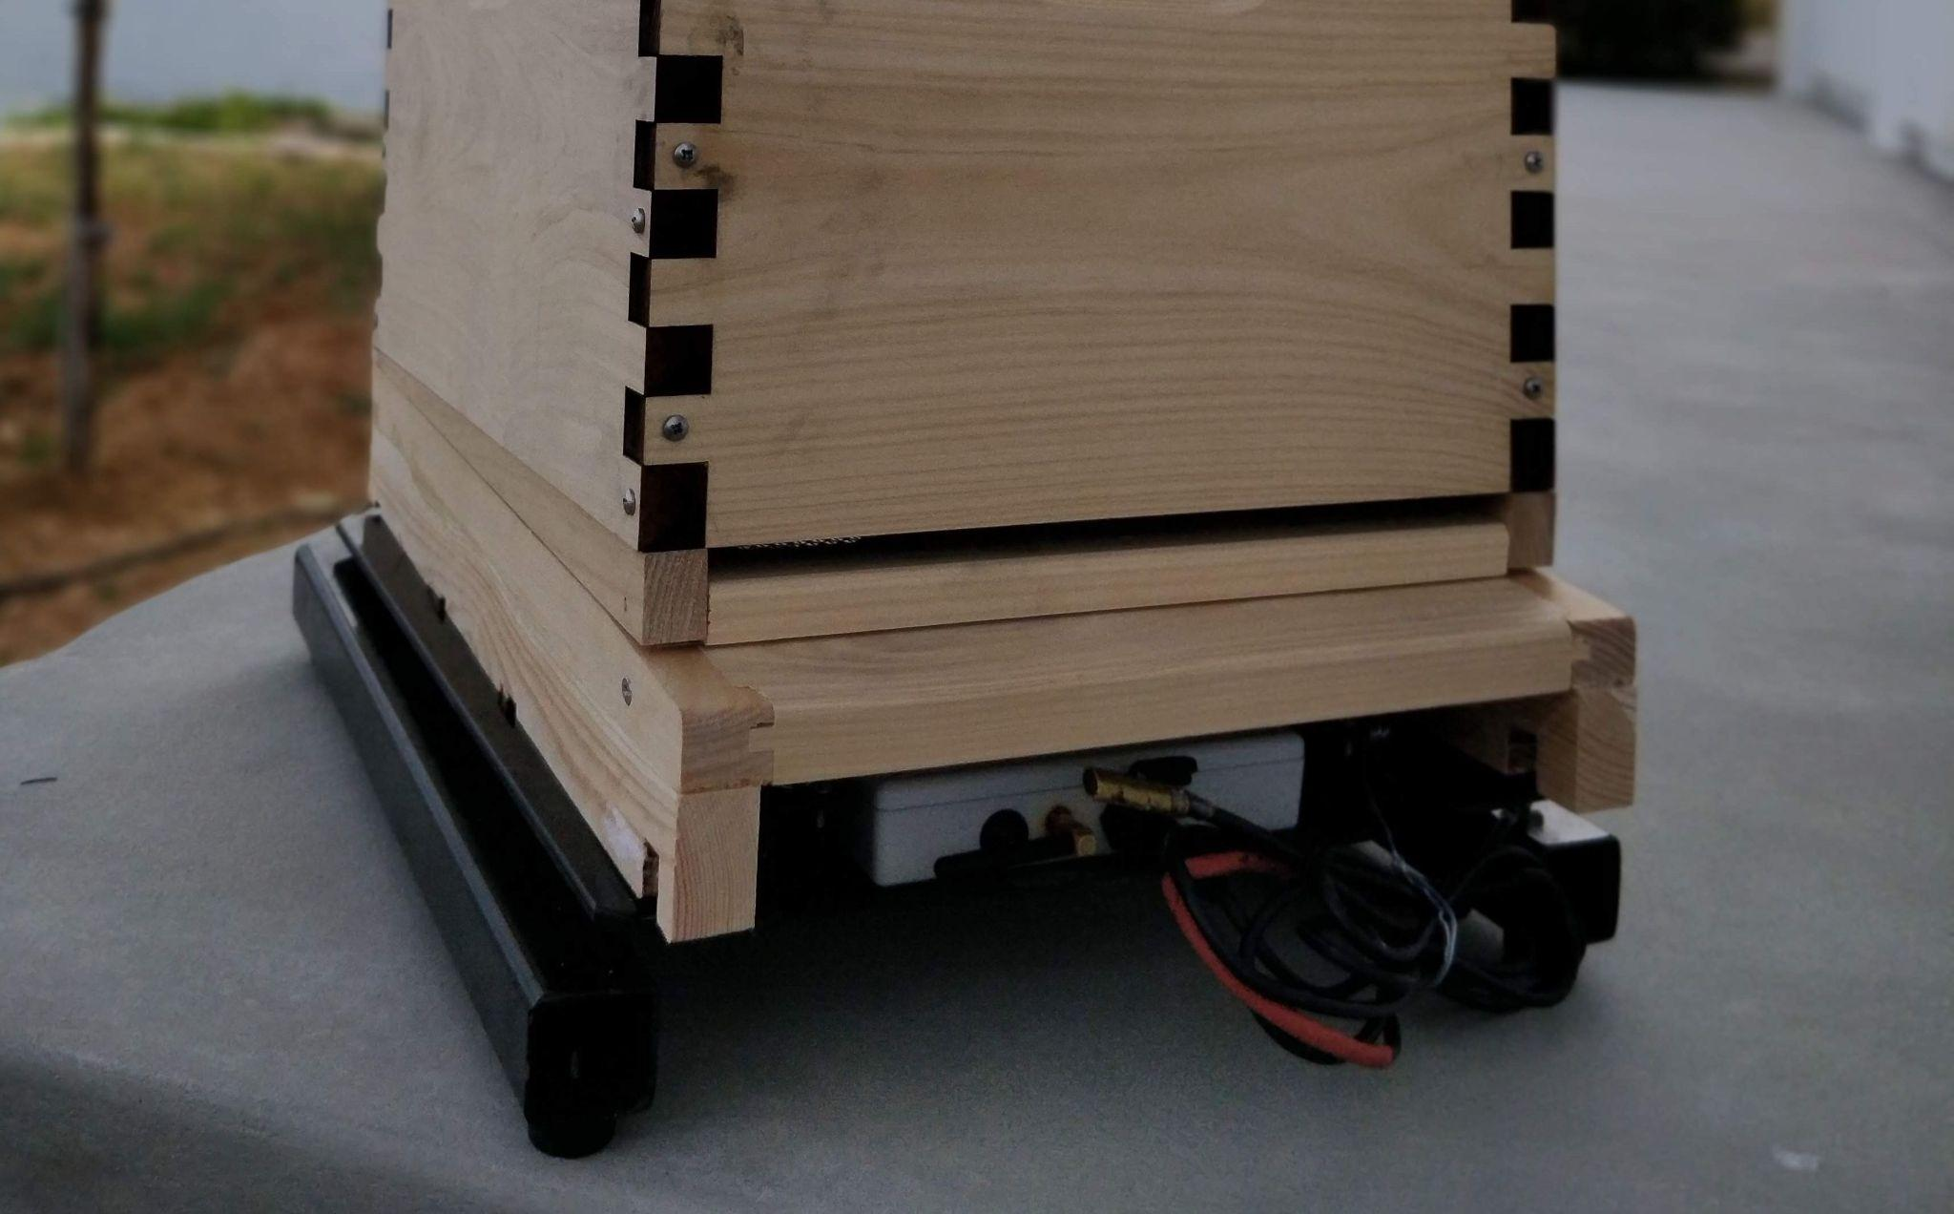
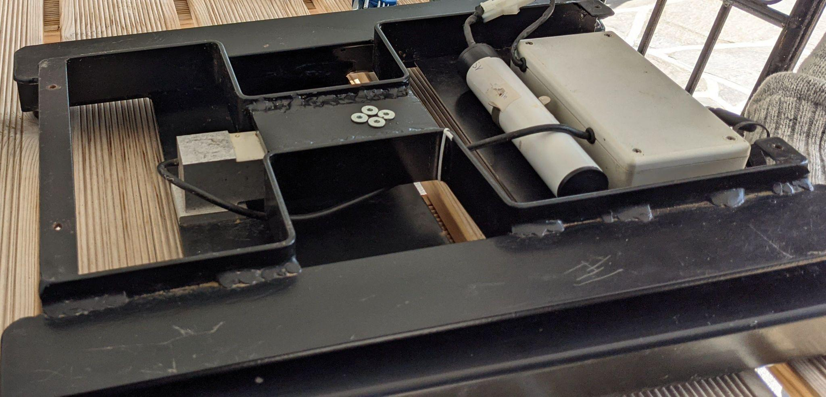
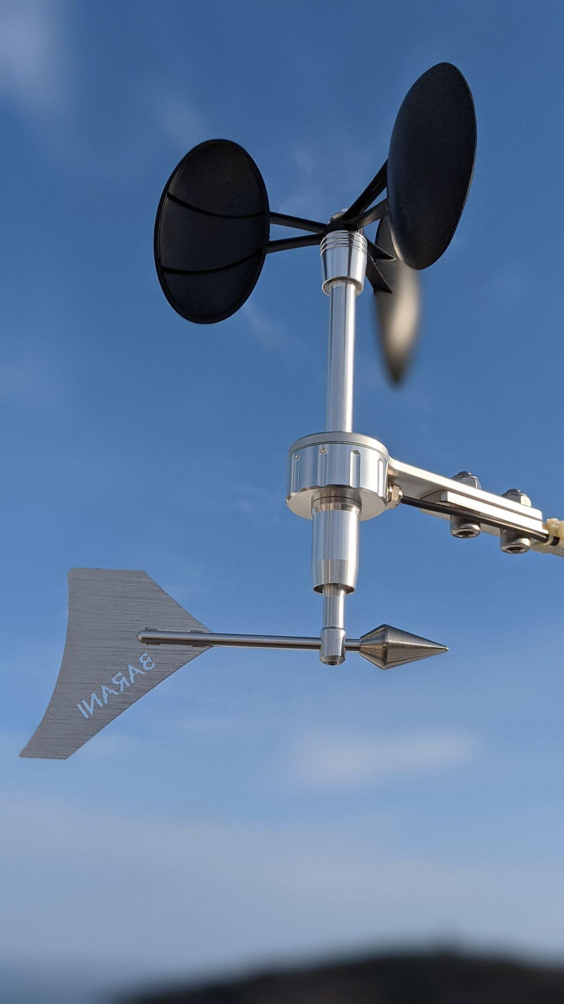
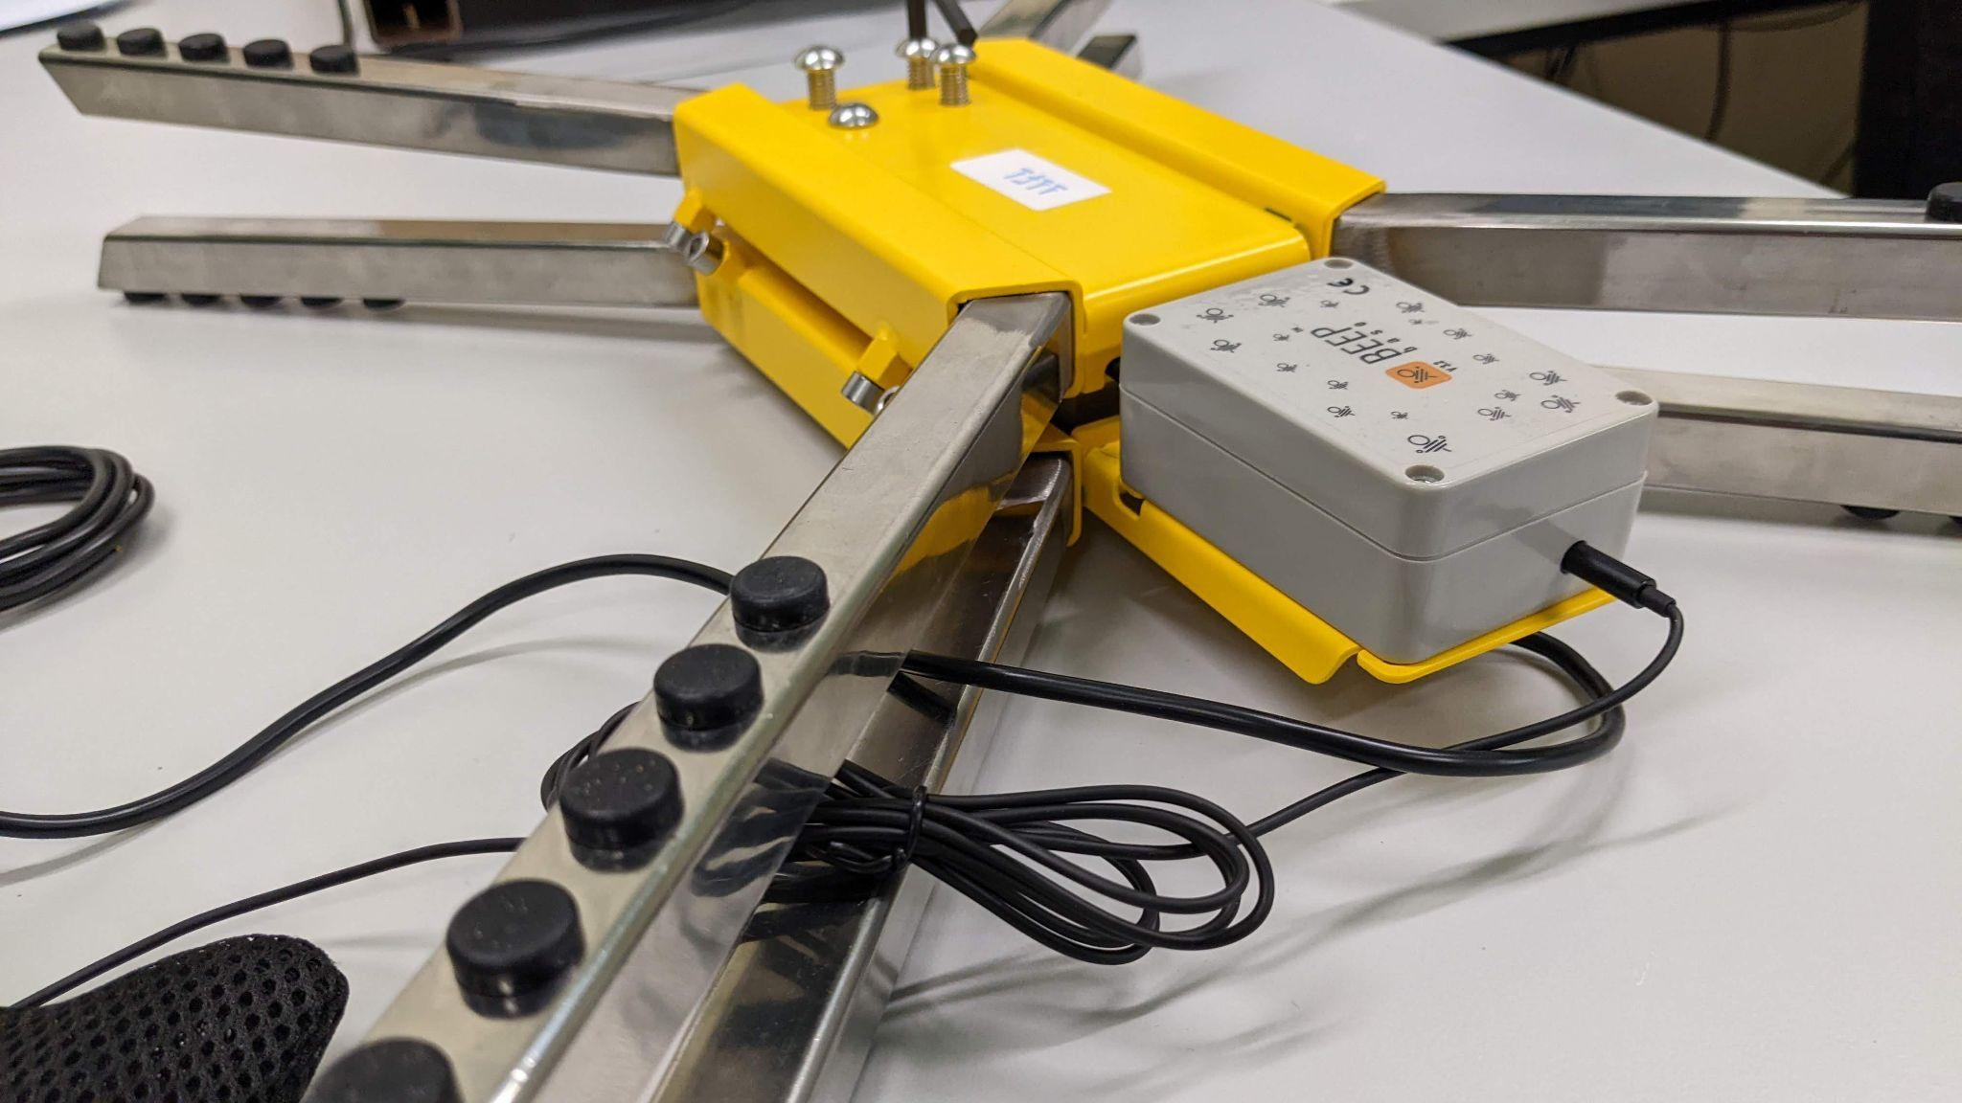
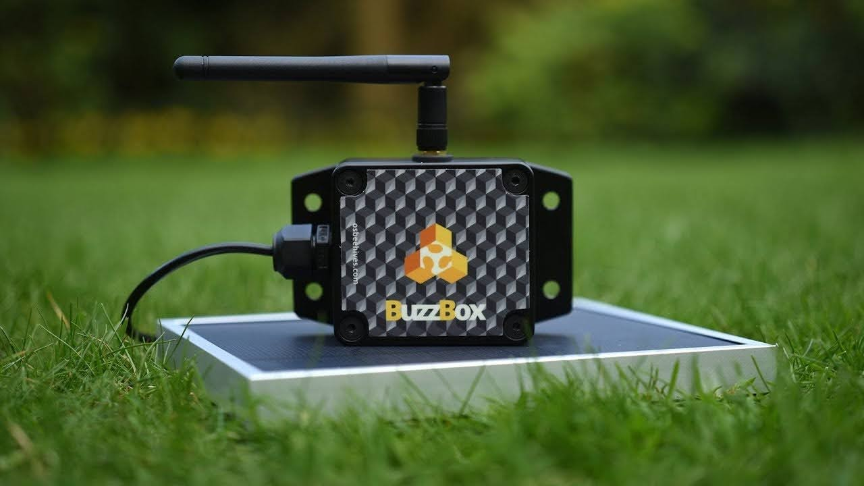
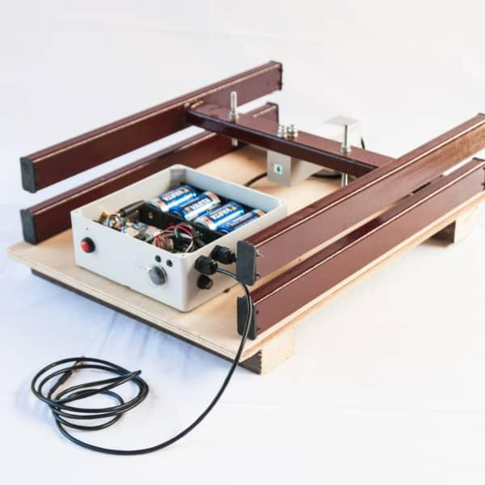
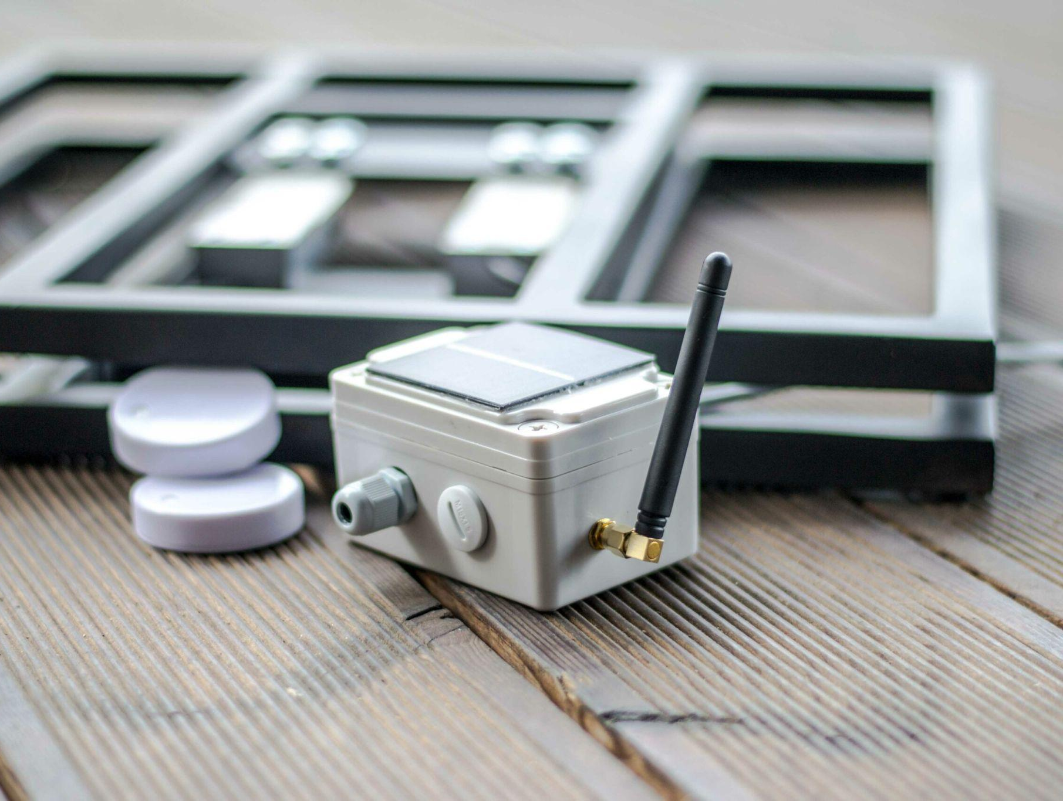
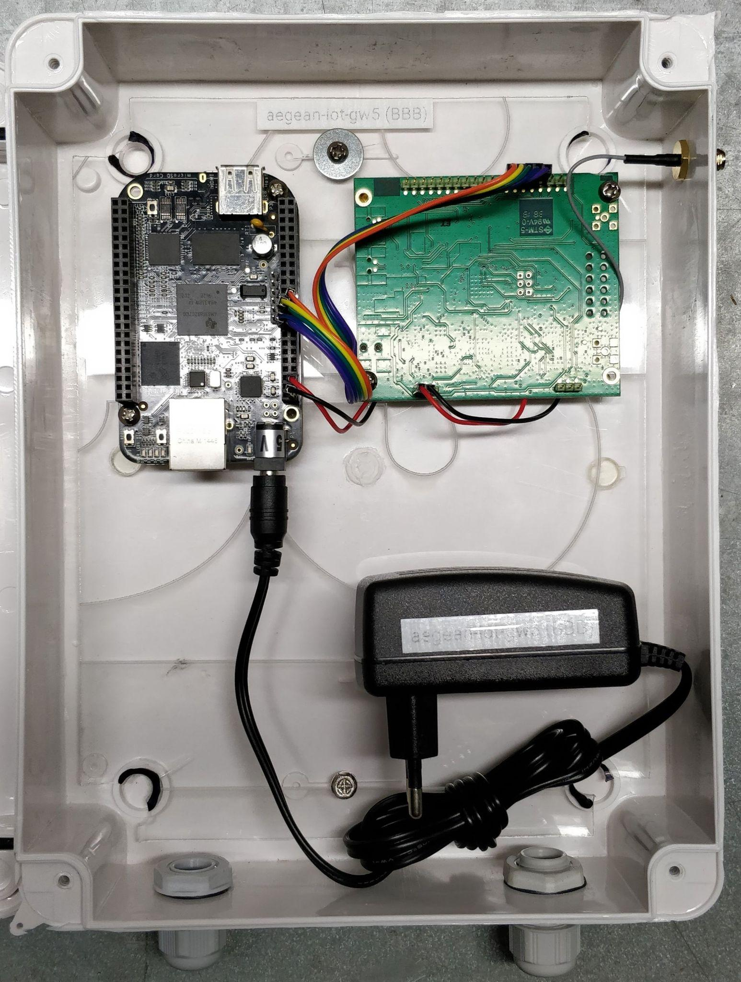
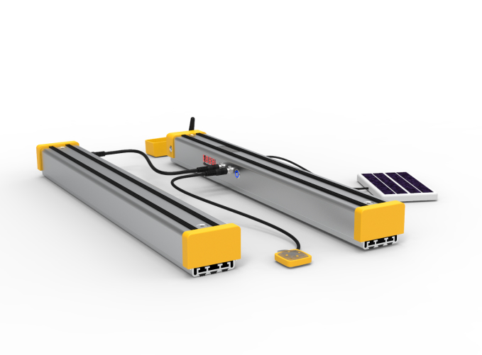
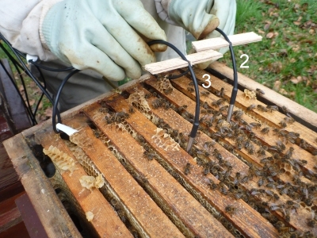
Sensors and weather stations

Slide 12
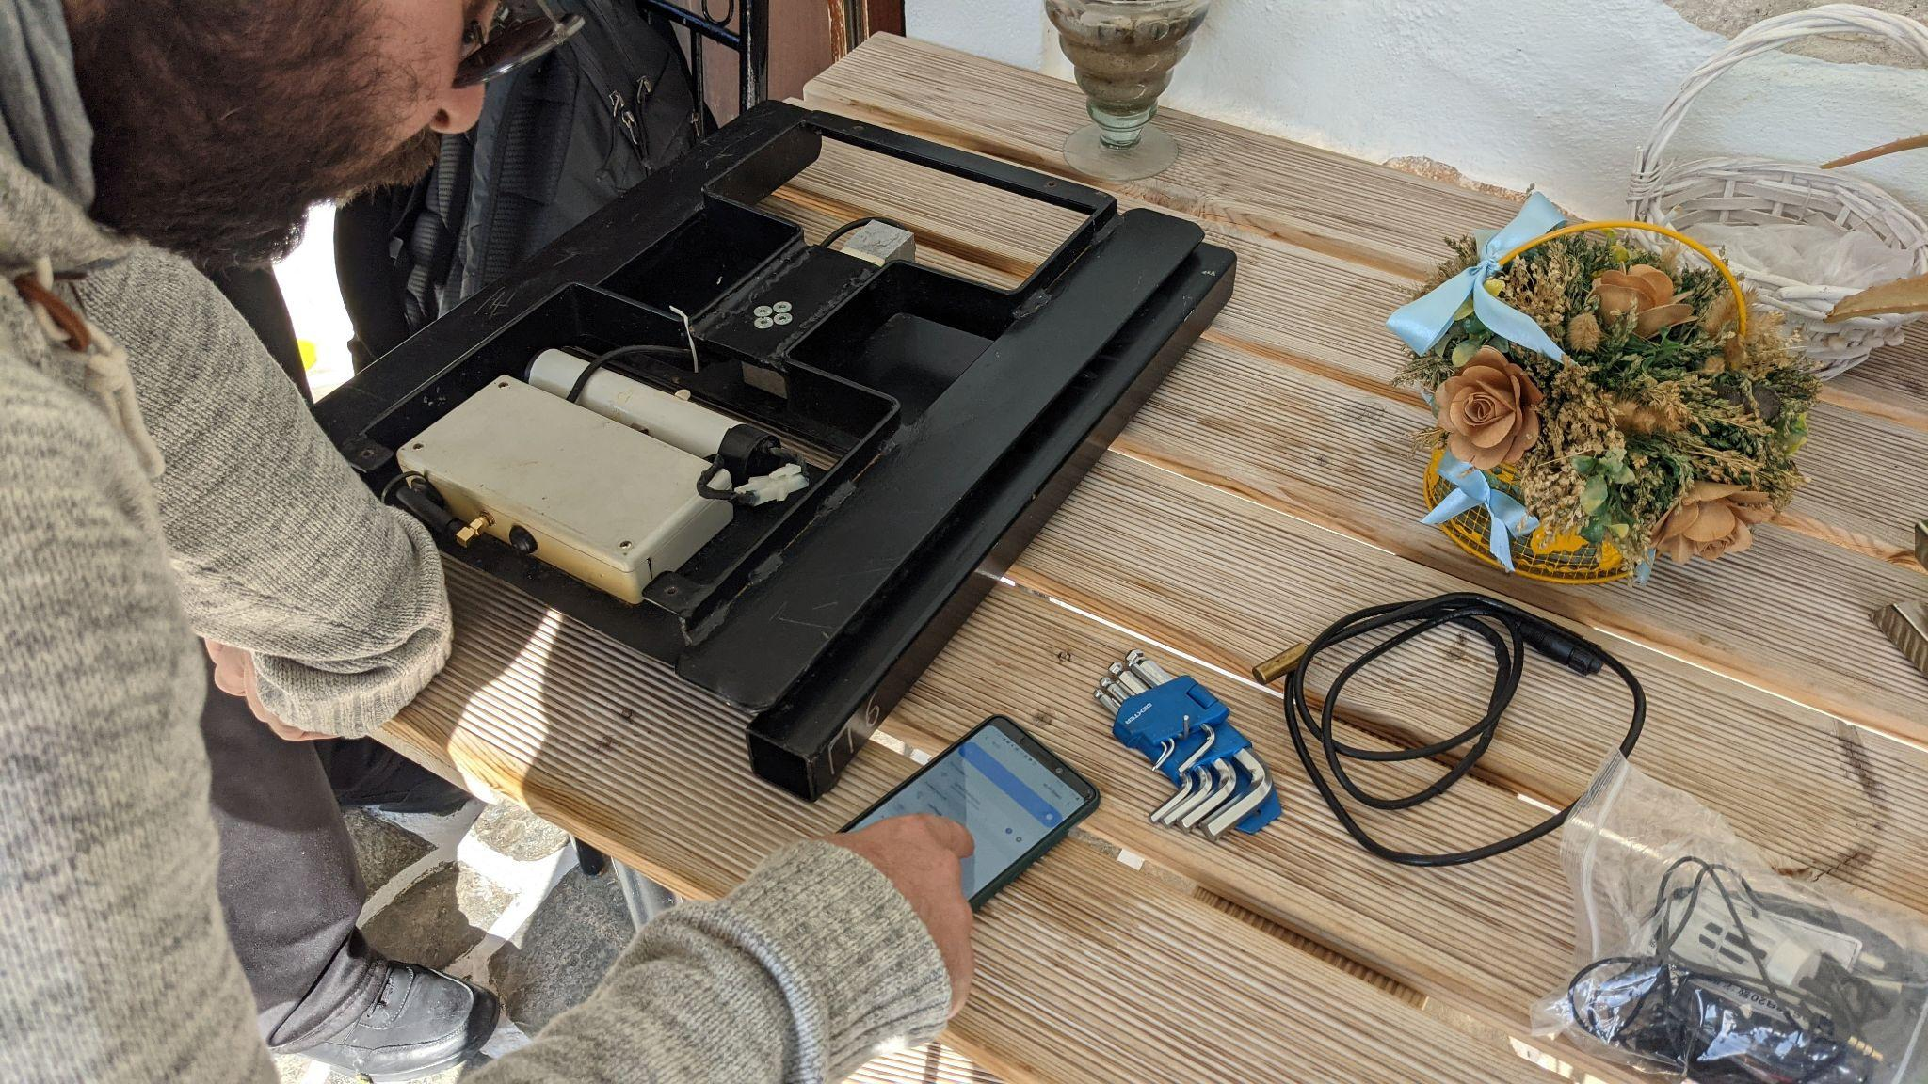
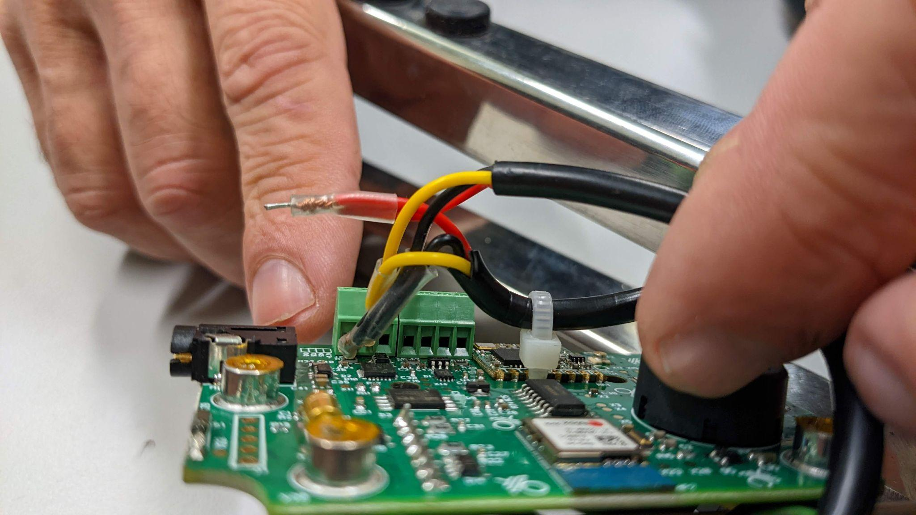
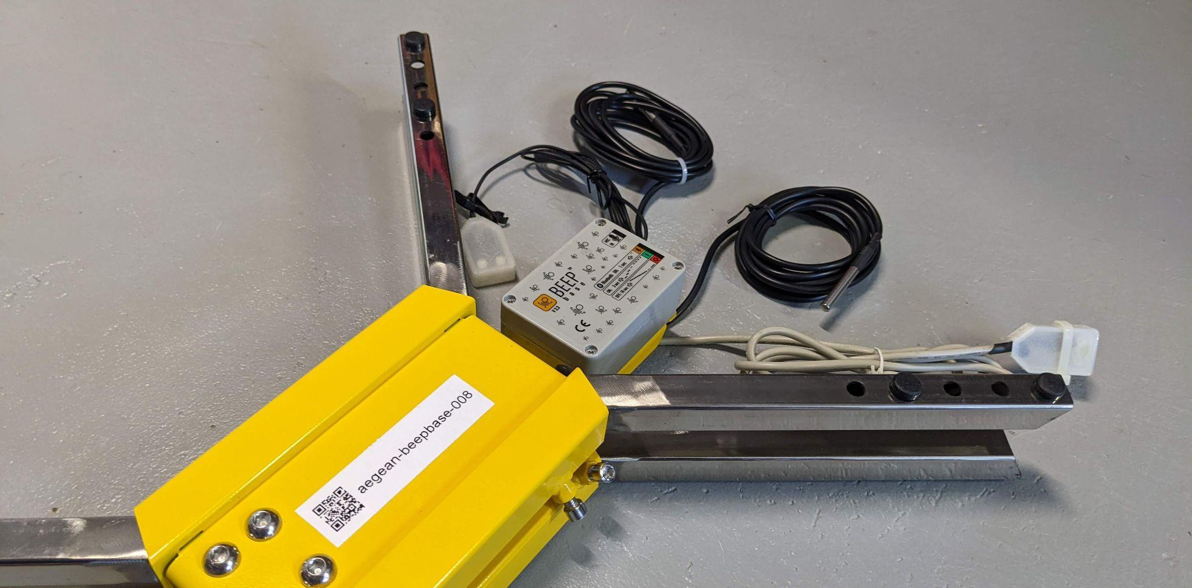
Beekeeping scale as
Swiss army knife

Slide 13
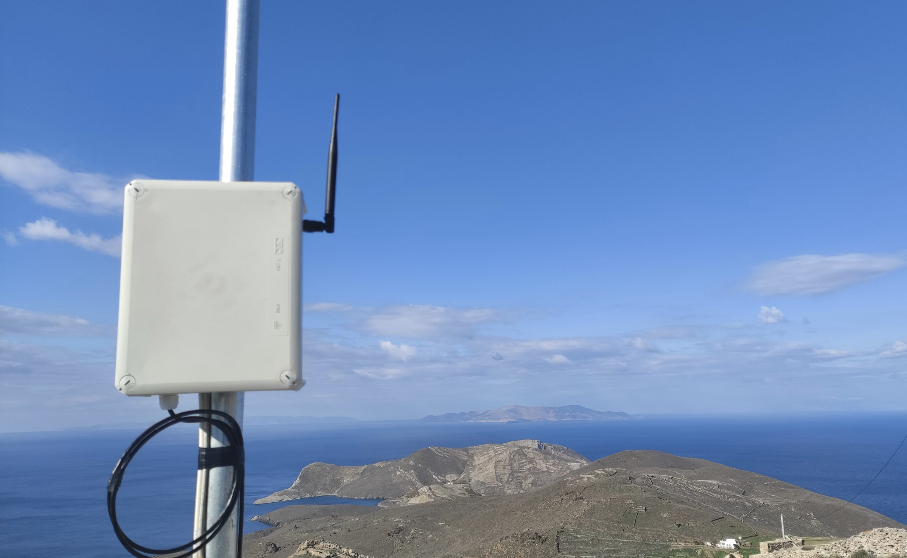
Network Installation
Gateways at Syros and Paros island

Slide 14
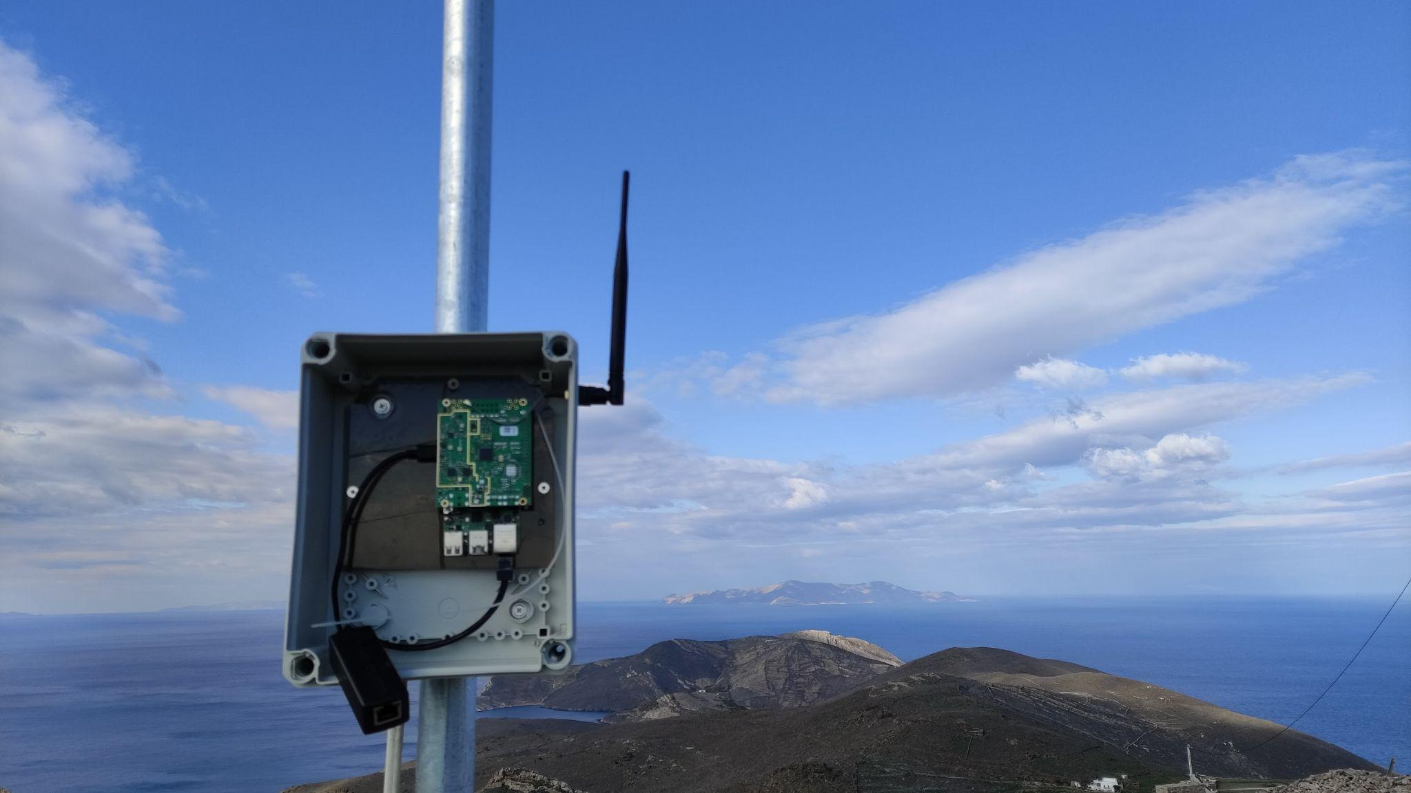
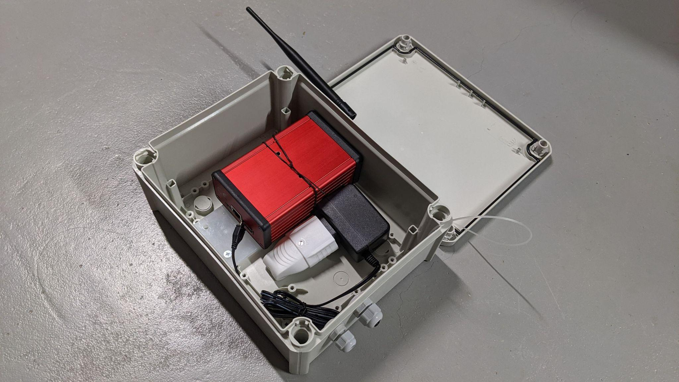
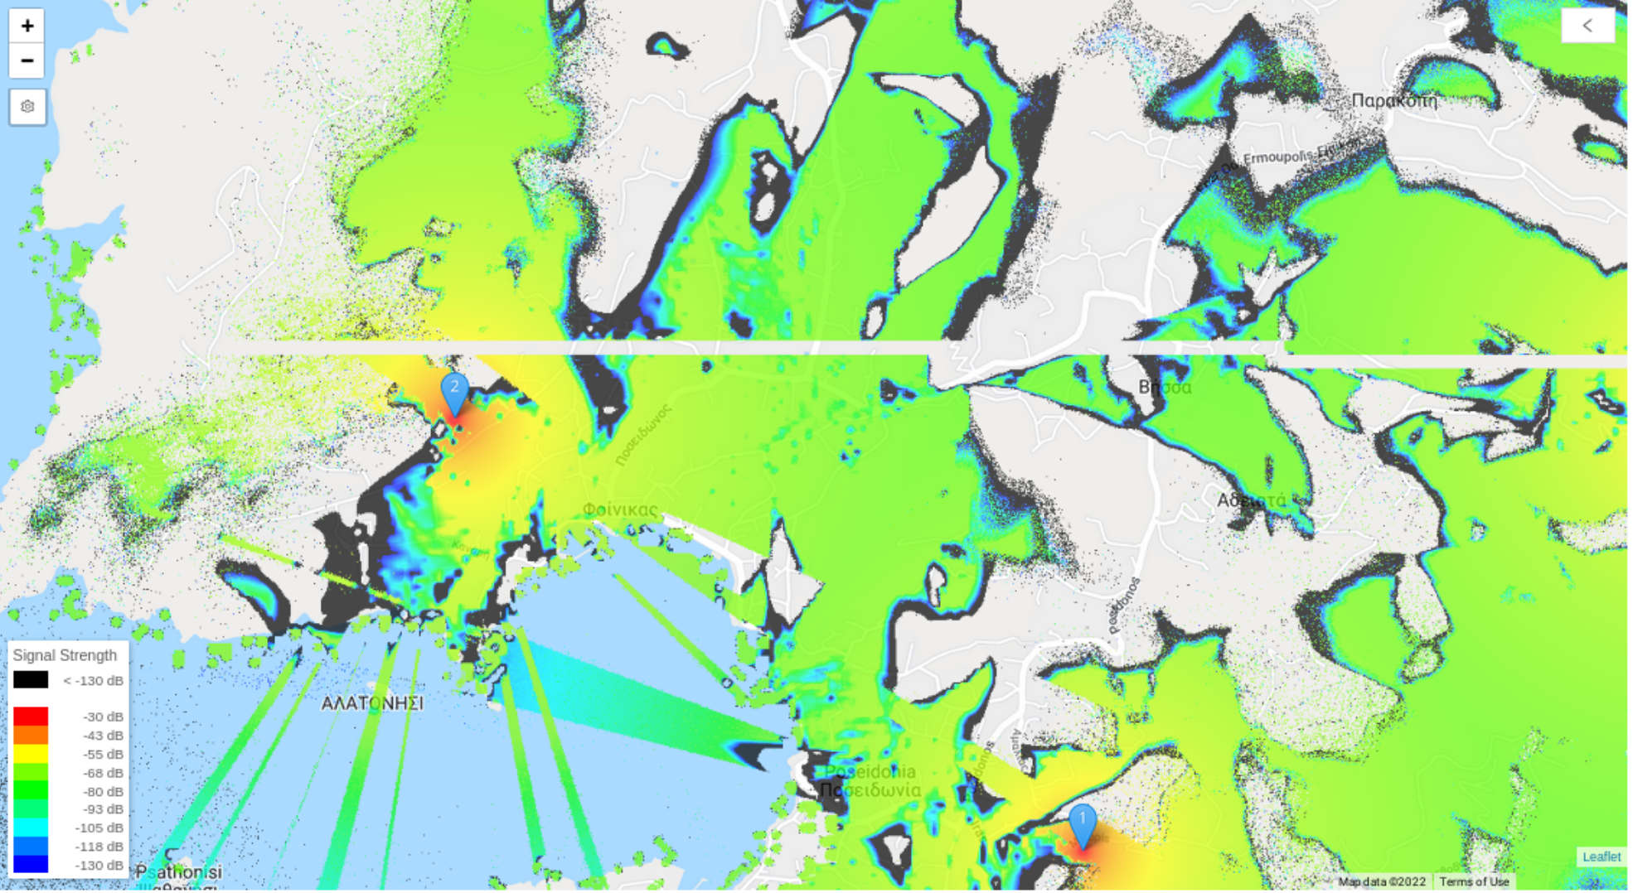
DIY LoRaWAN Gateways
(e.g. RaspberryPi, LoRa Concentrator)
Gateway placement simulation

Slide 15
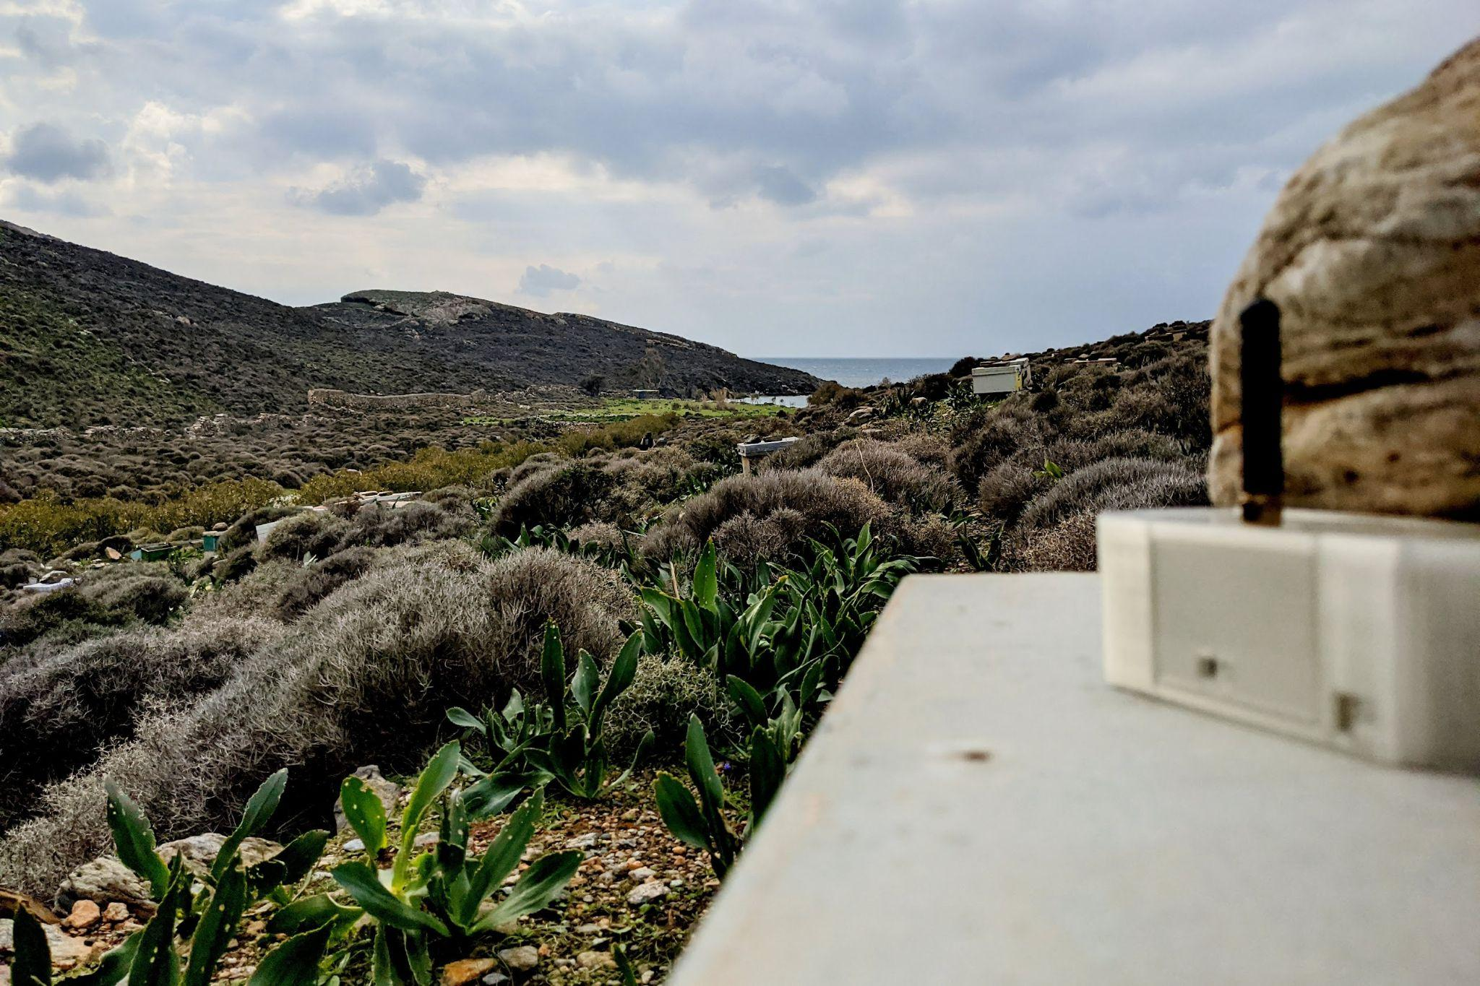

Slide 16
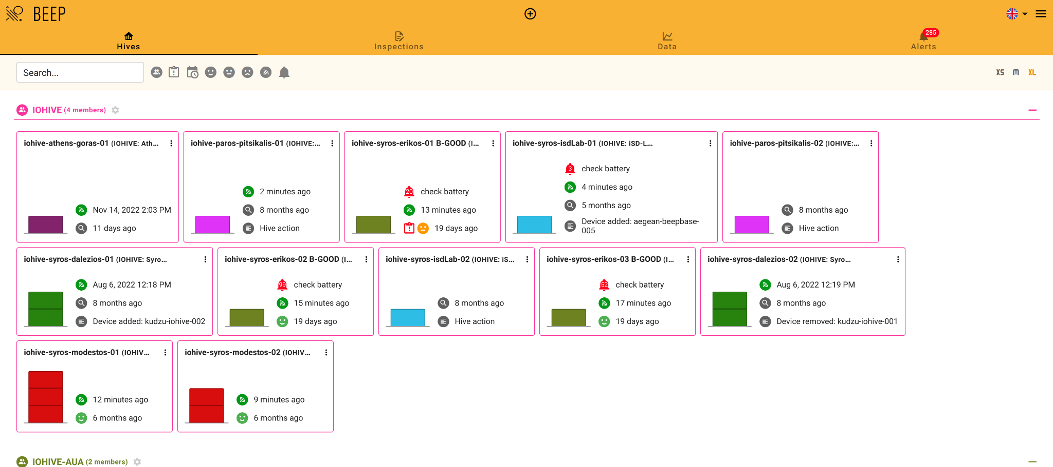
Hive management

Slide 17
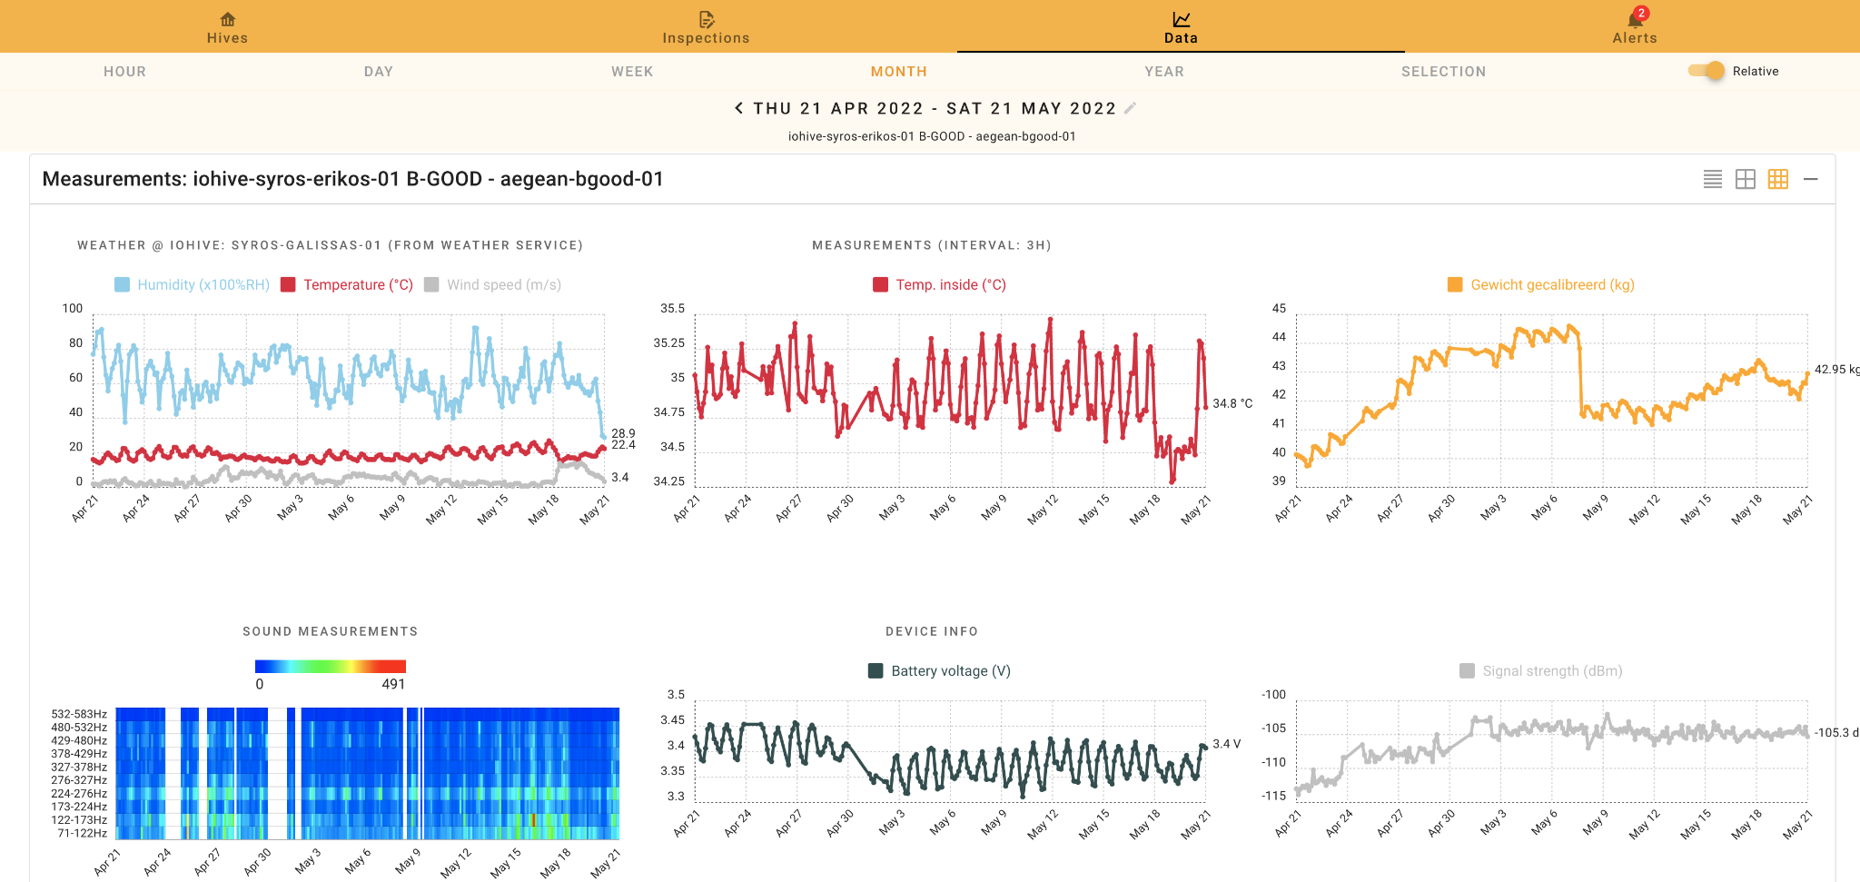
Sensor data visualization (BEEP app)

Slide 18
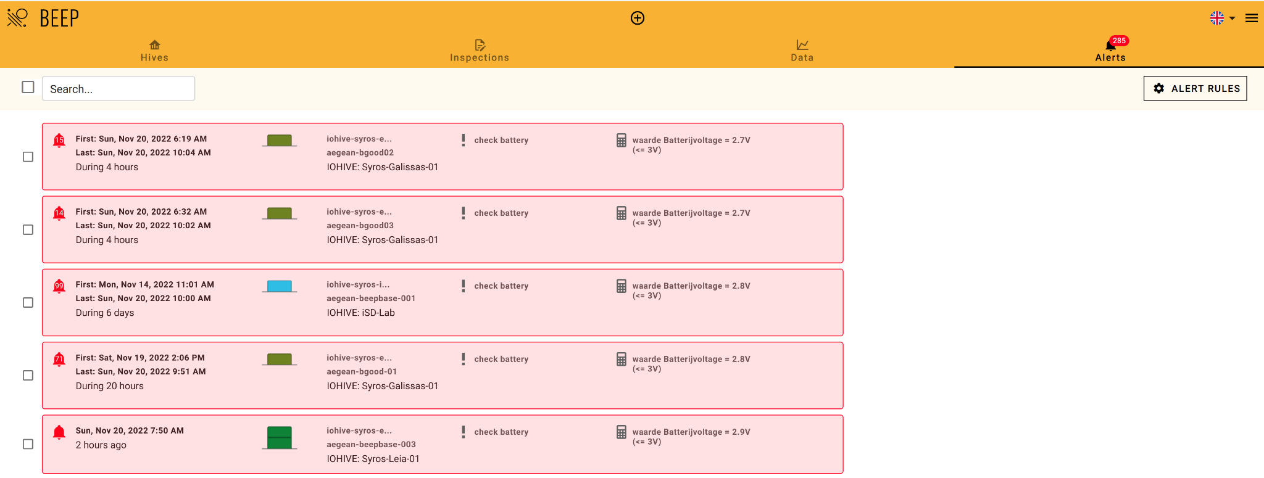
Alerting mechanism

Slide 19
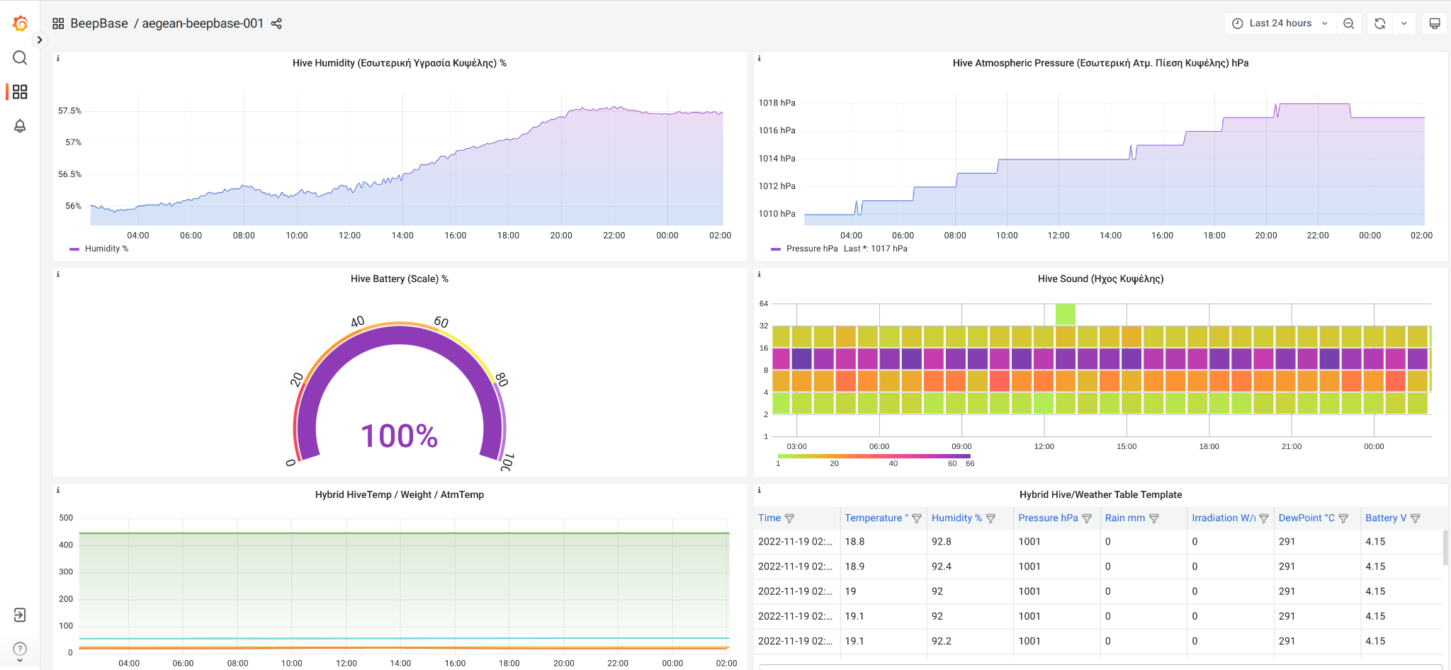
Extra data visualization (Grafana dashboards)

Slide 20
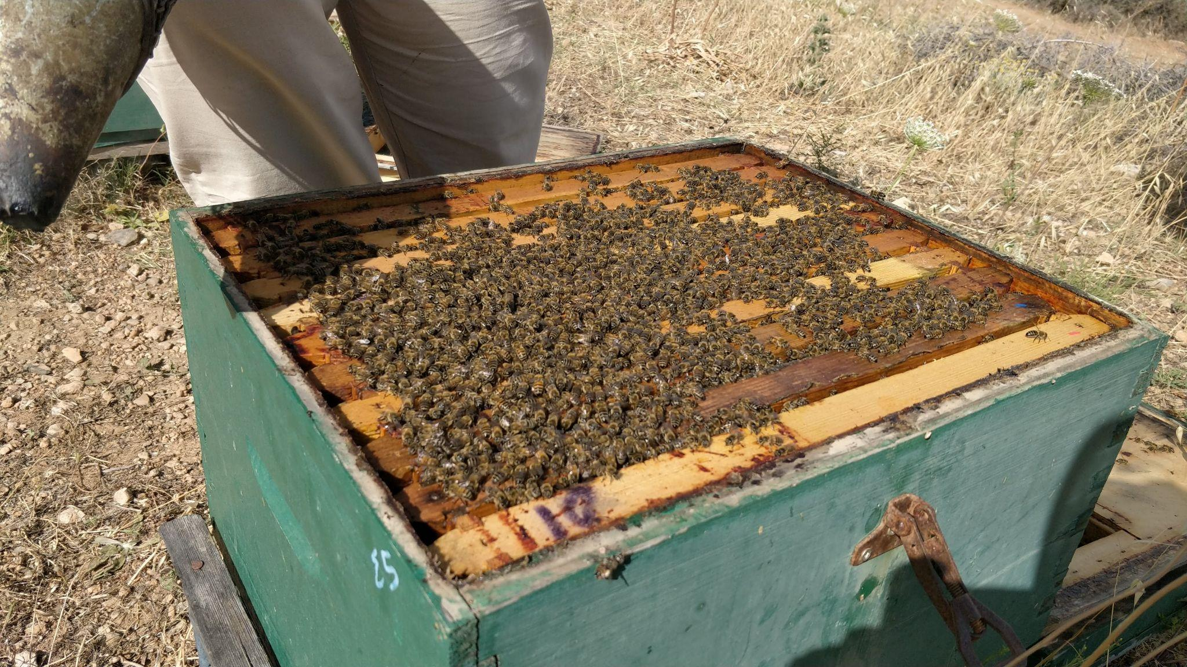
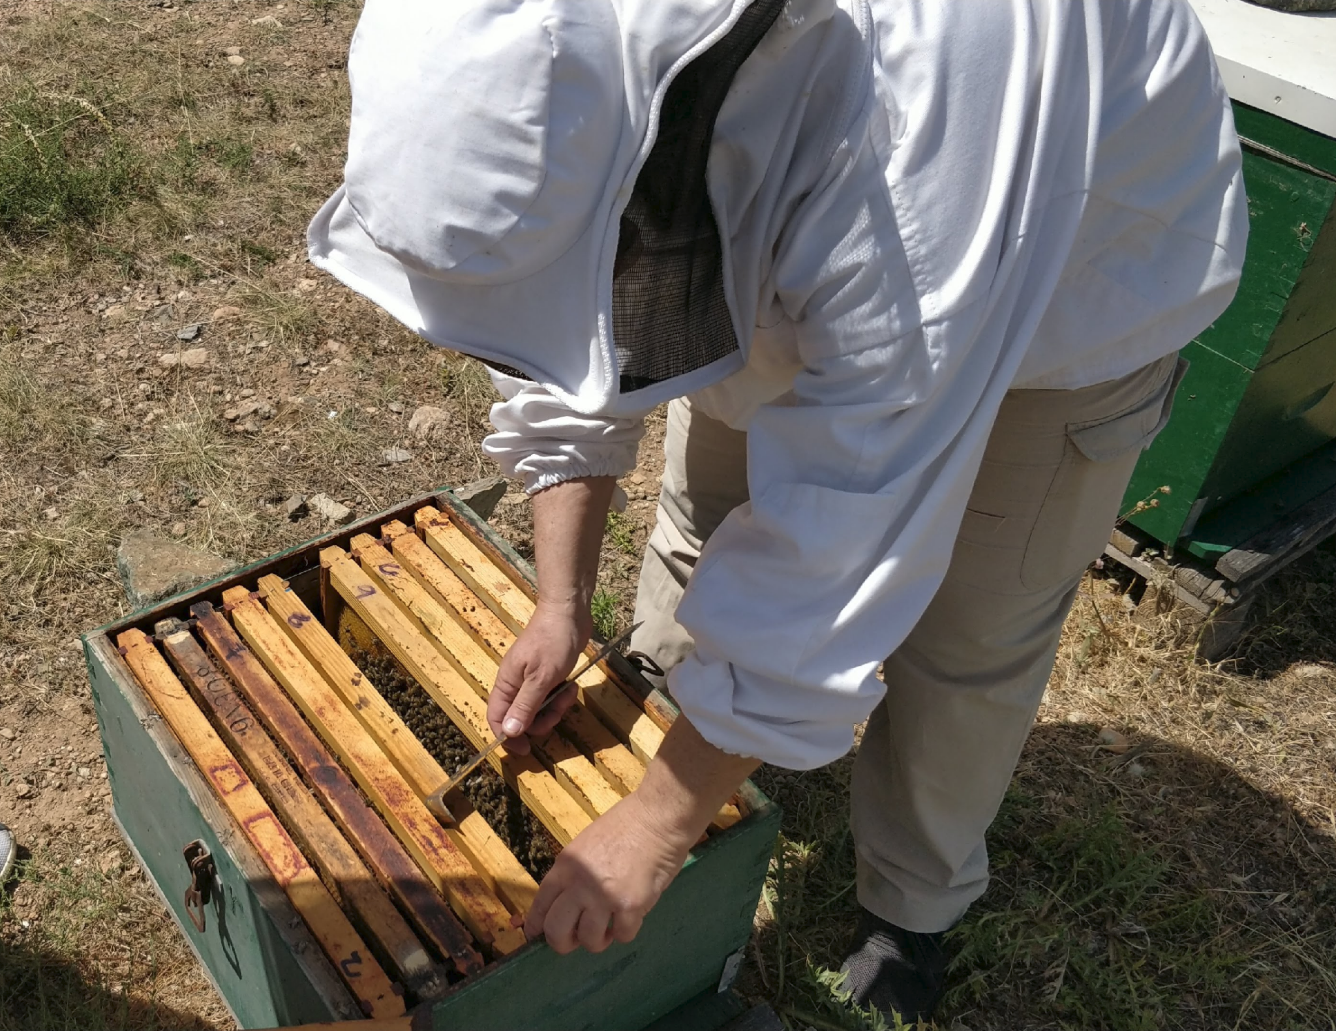
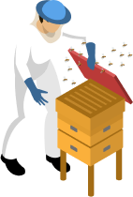
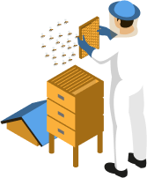
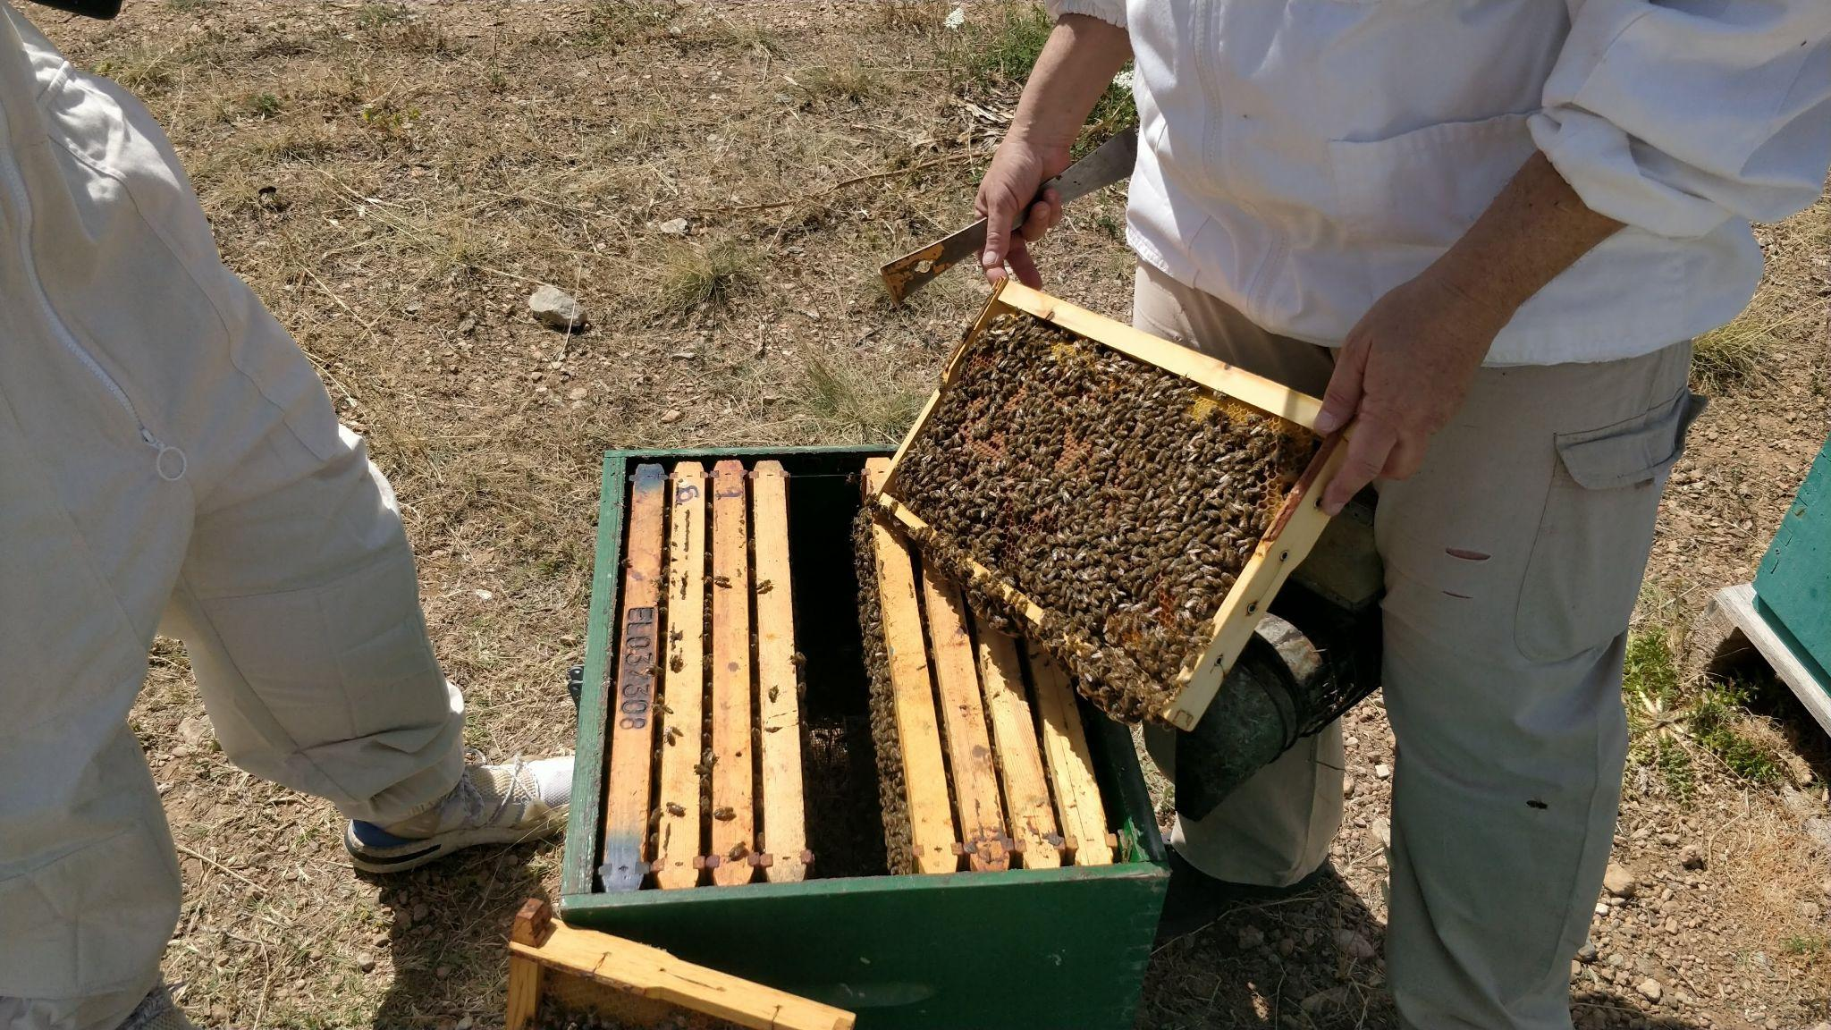
Inspections
Observation
Intervention

Slide 21
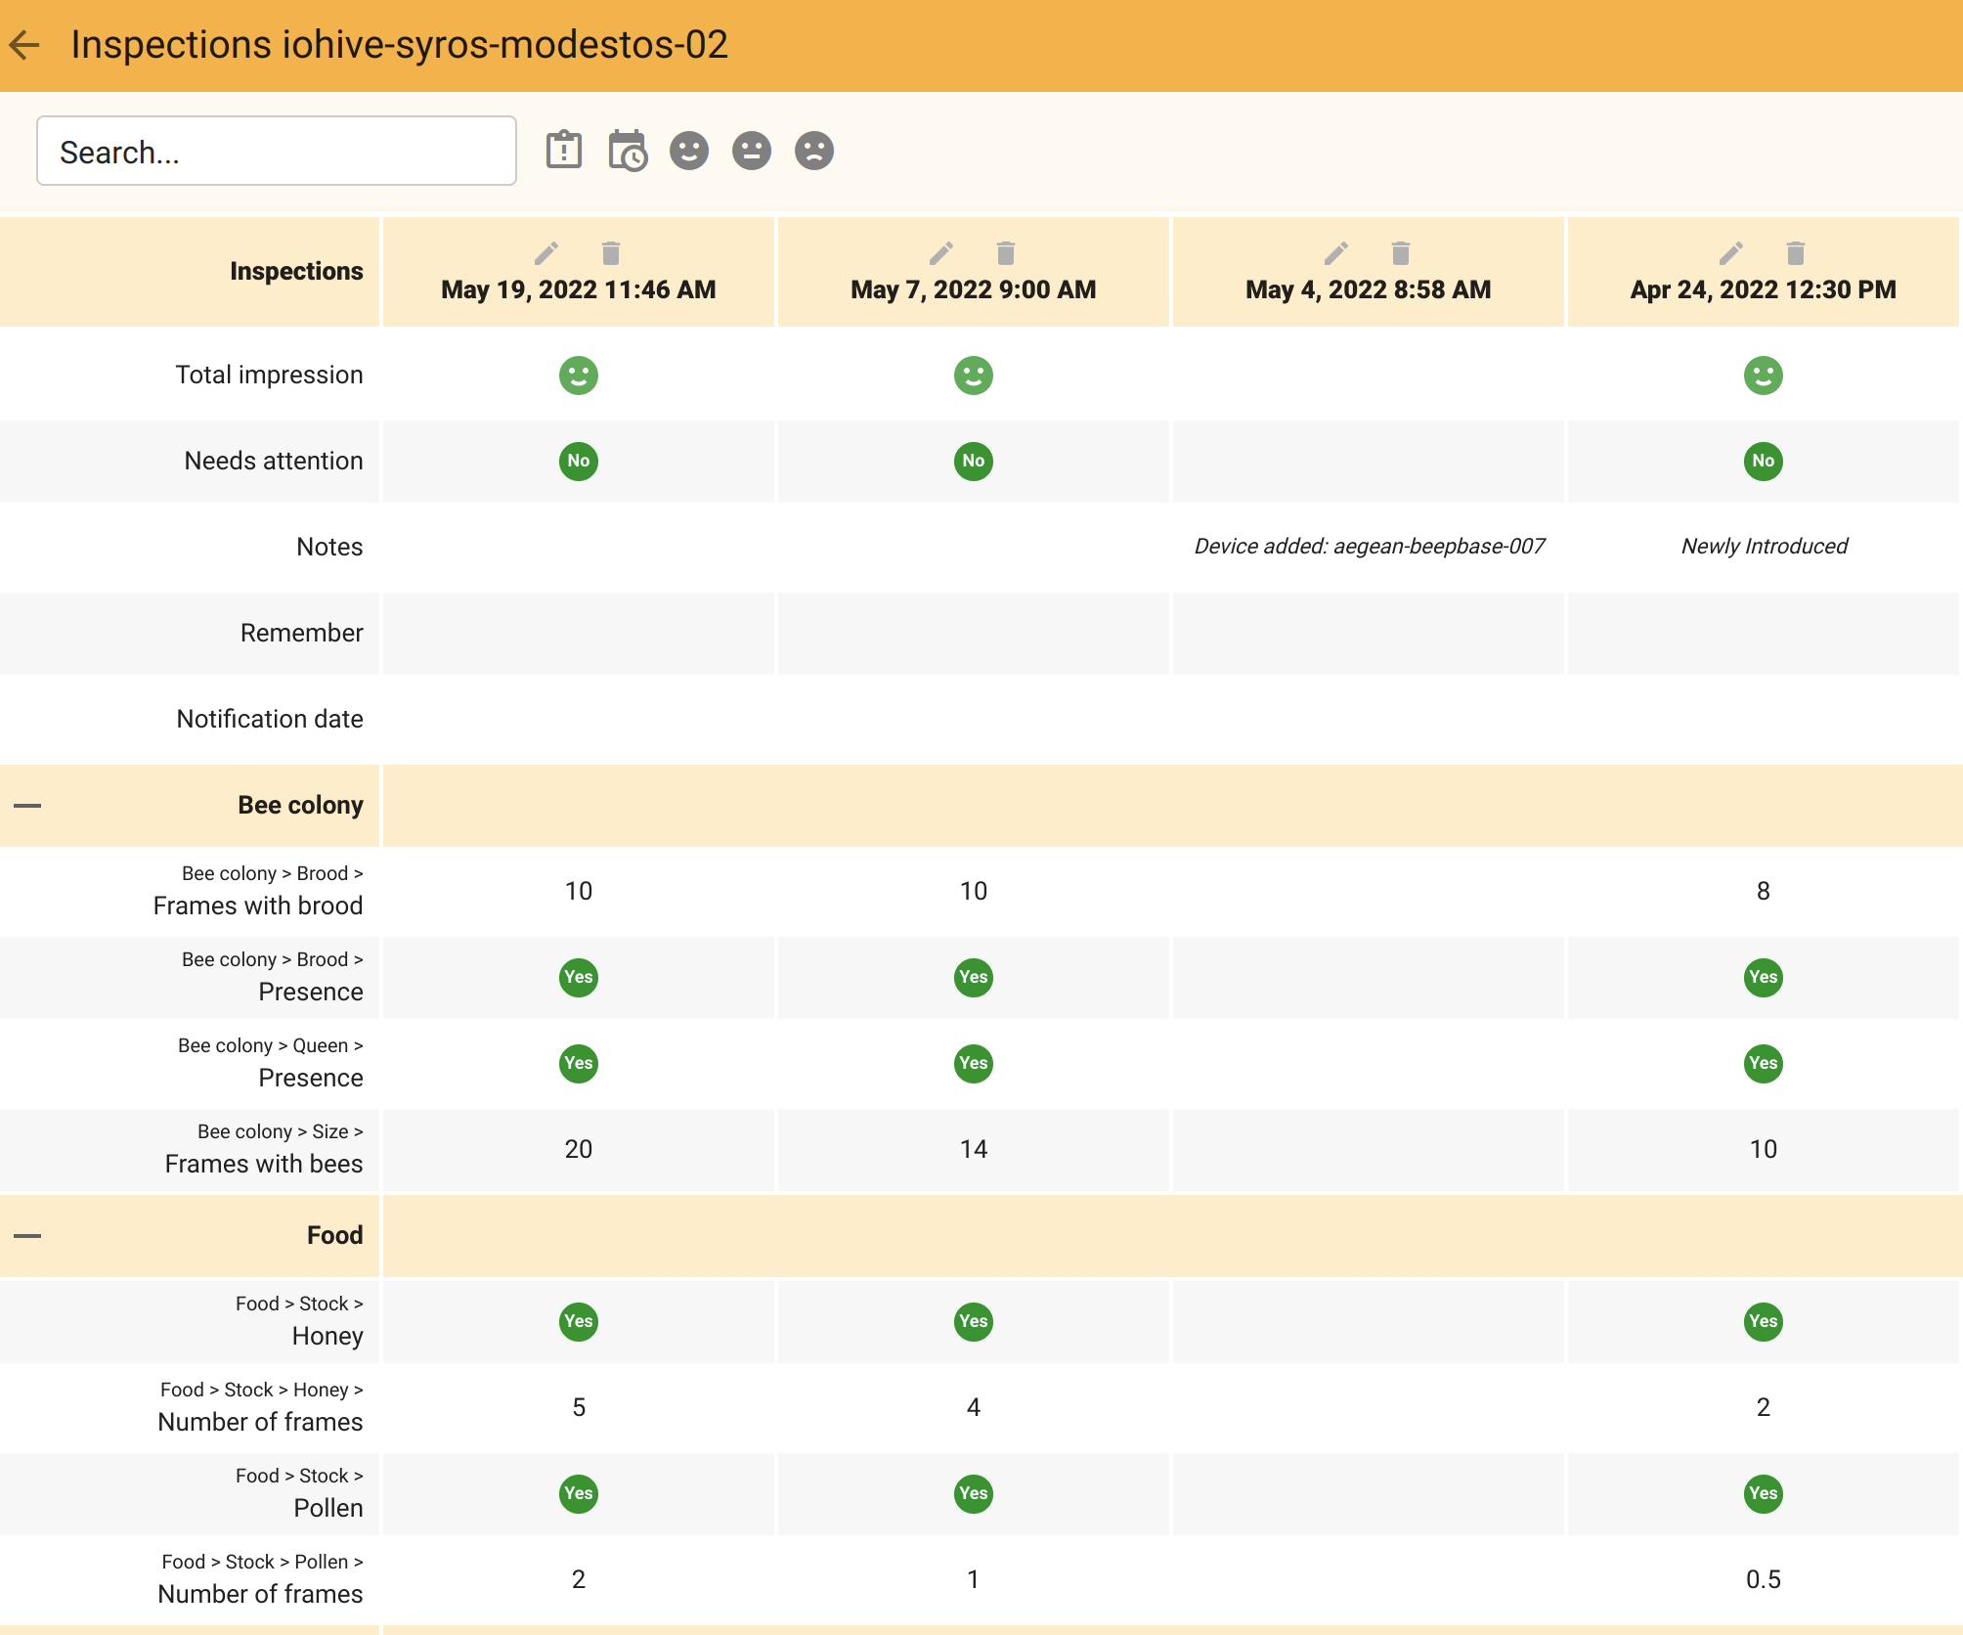
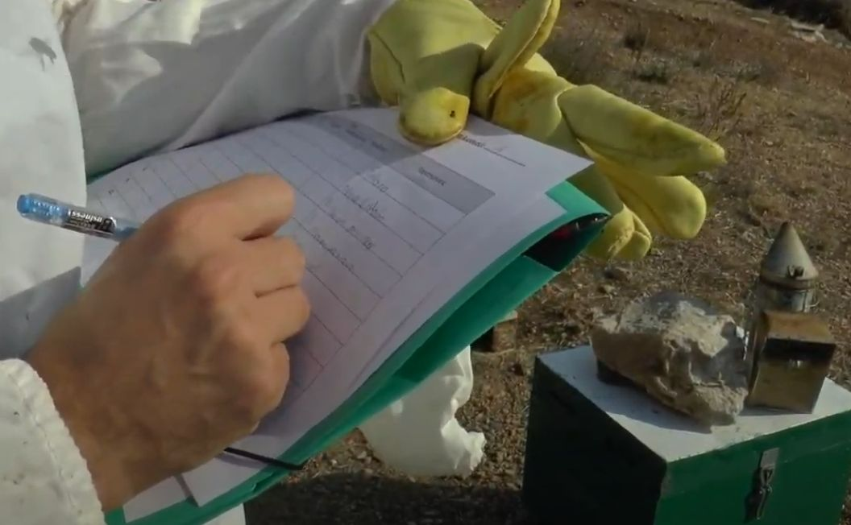
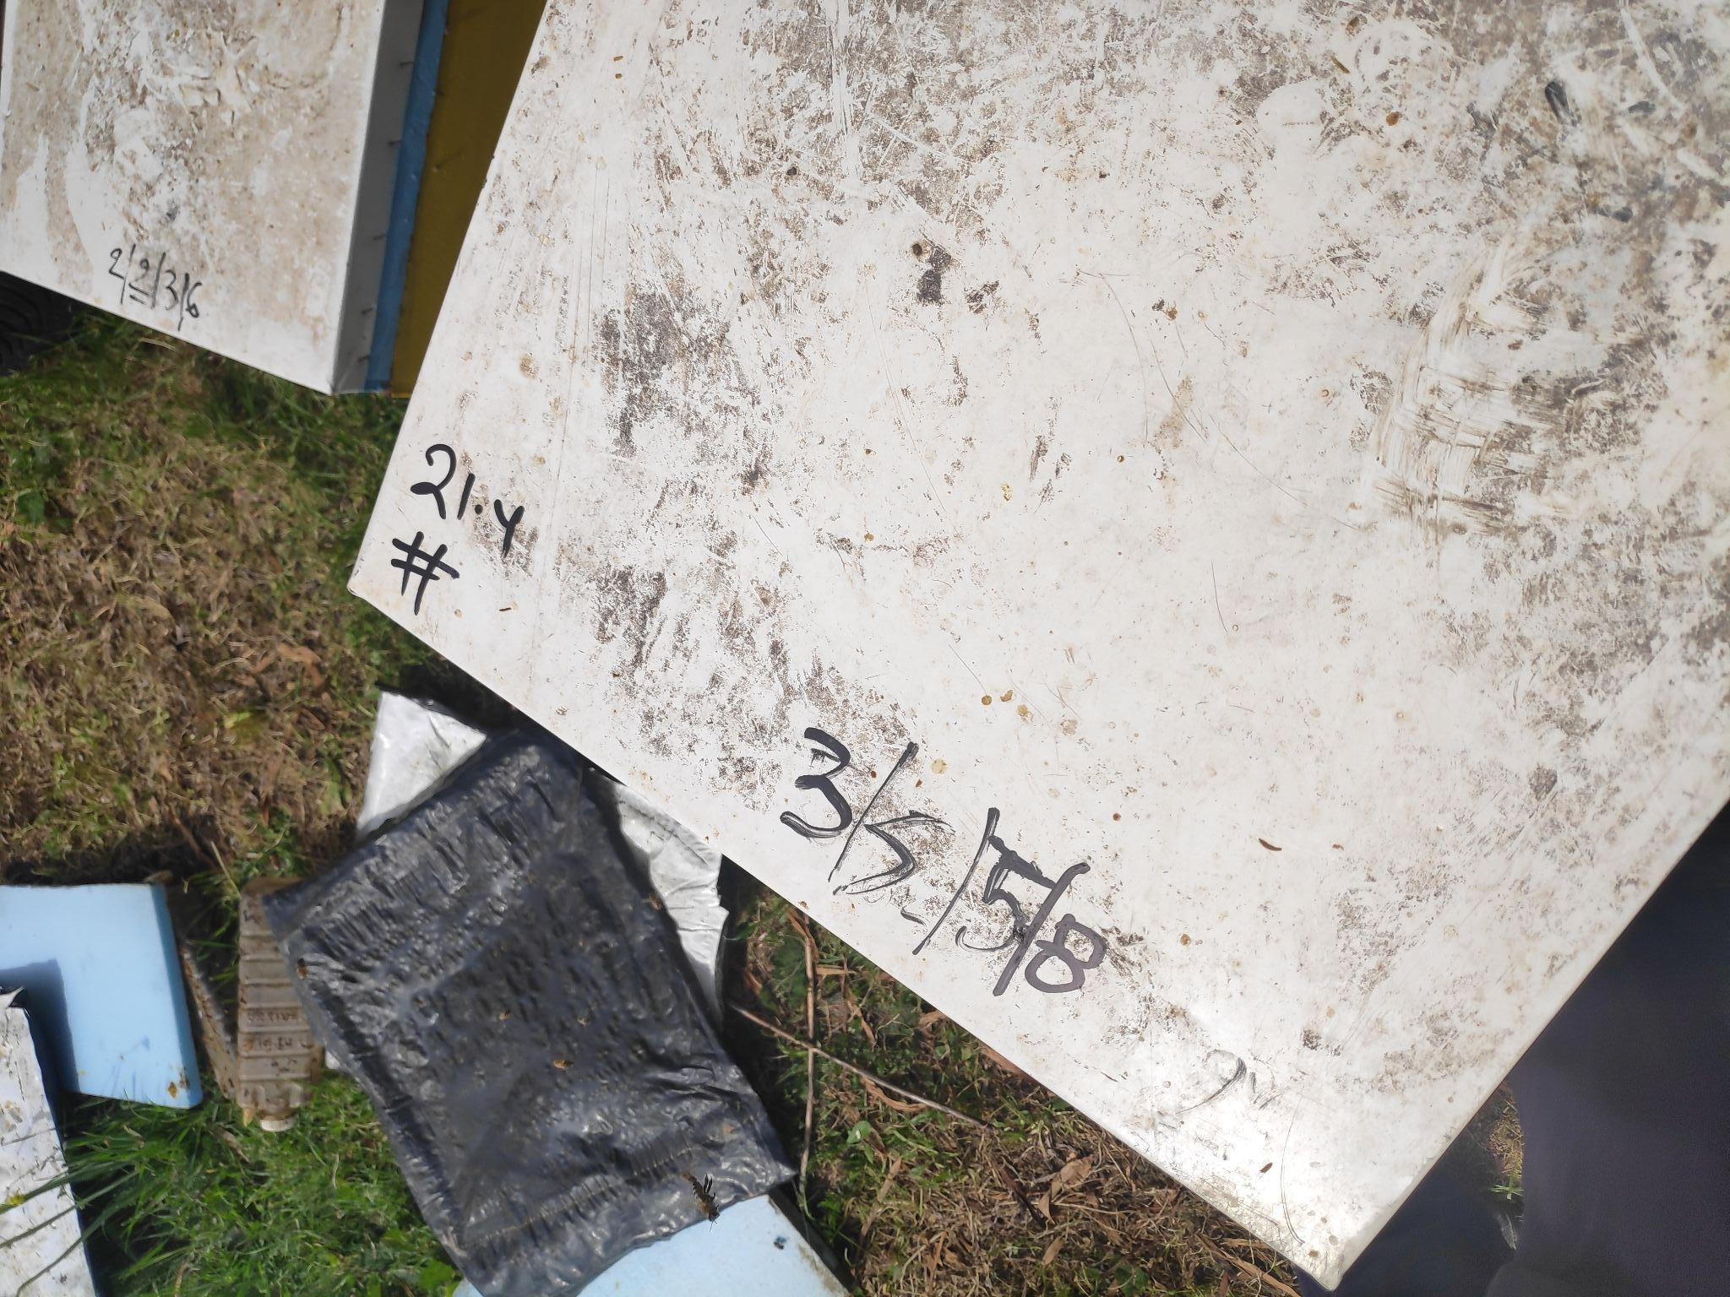
Journaling
=>

Slide 22
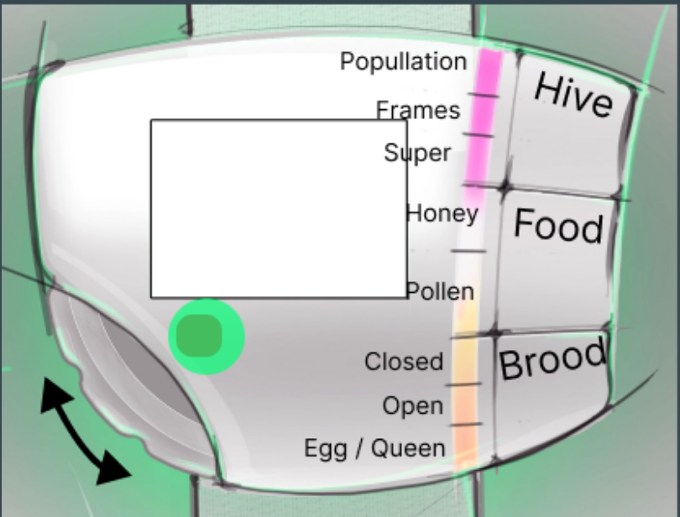
IOHIVE wearable: concept development
Minimal
Inspection Scenario
Hive identification
Number of frames
Frames with food
Frames with brood
Queen presence
Bee population
Overall impression
Needs attention

Slide 23
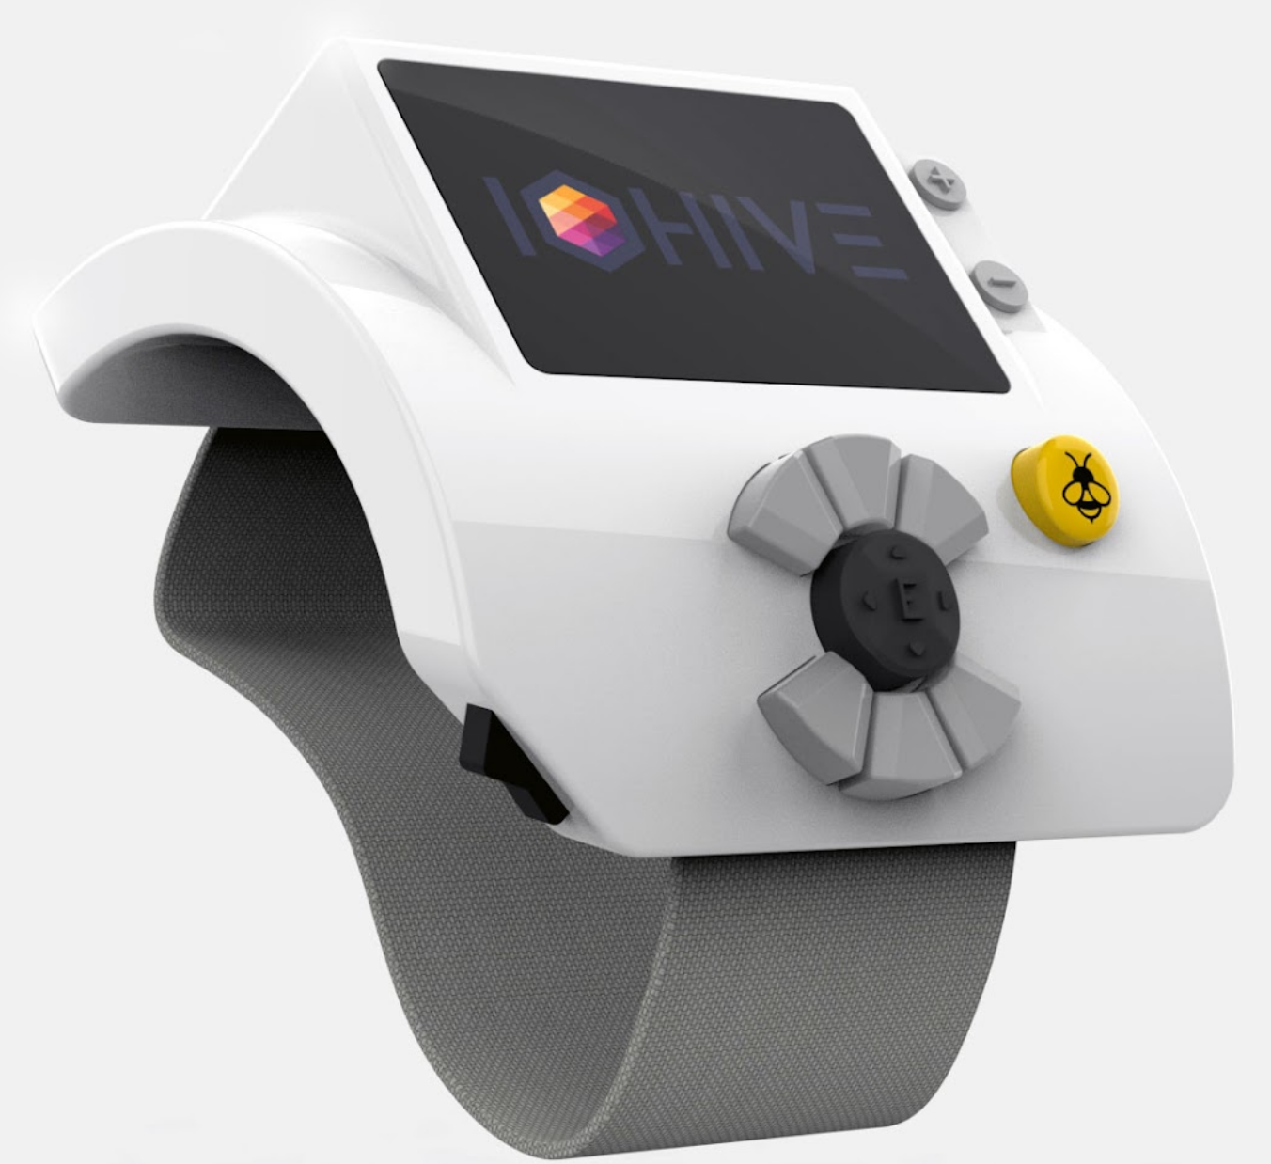
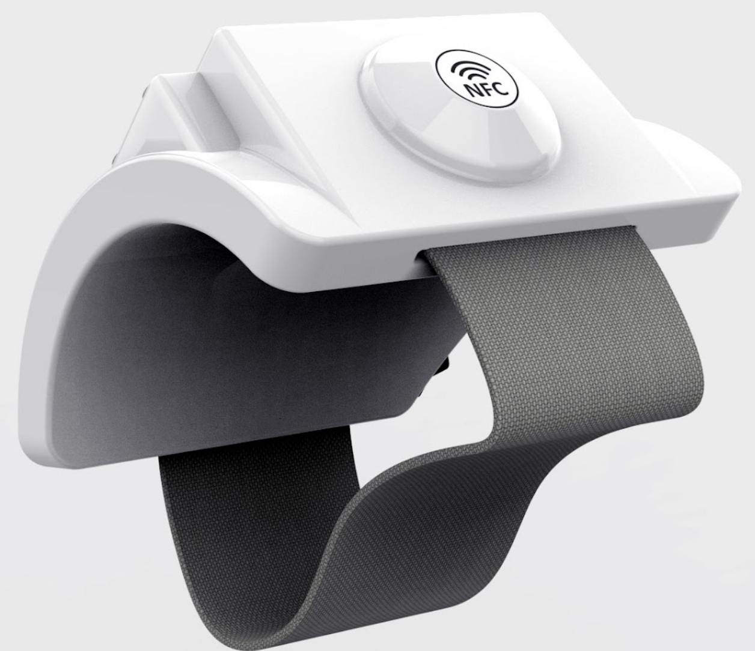
IOHIVE wearable: concept development

Slide 24
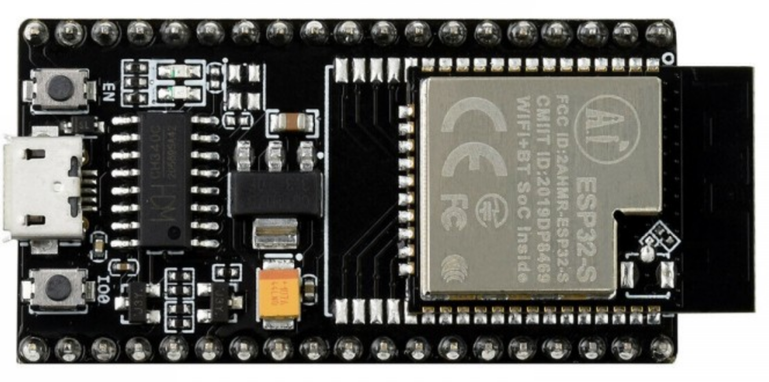
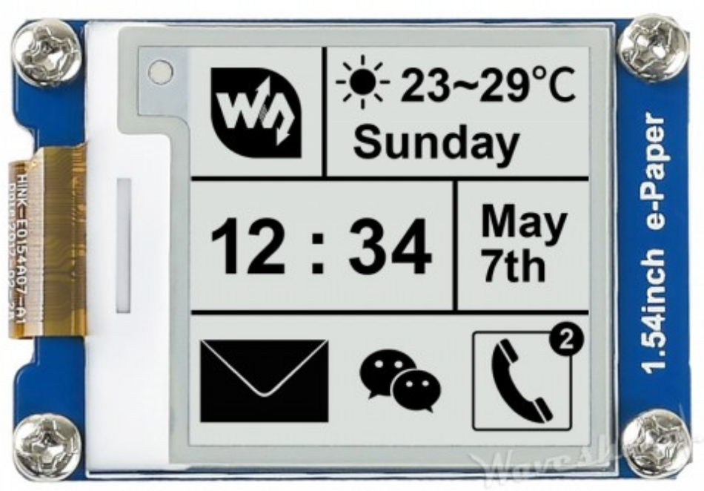
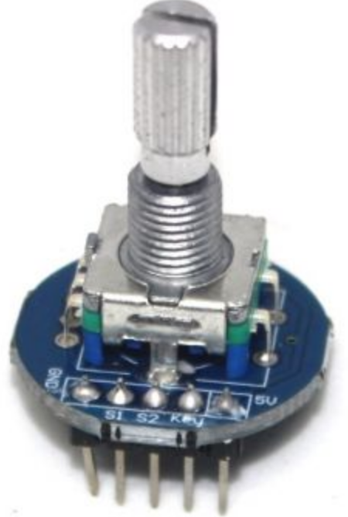
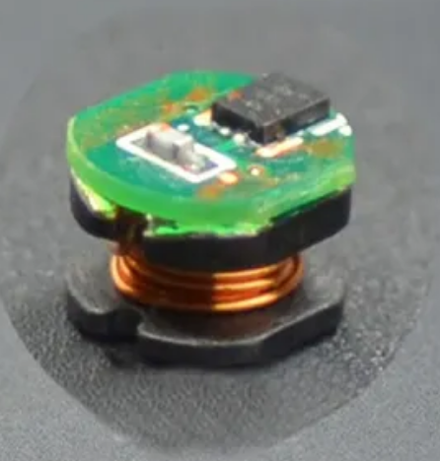
IOHIVE wearable: component list

Slide 25
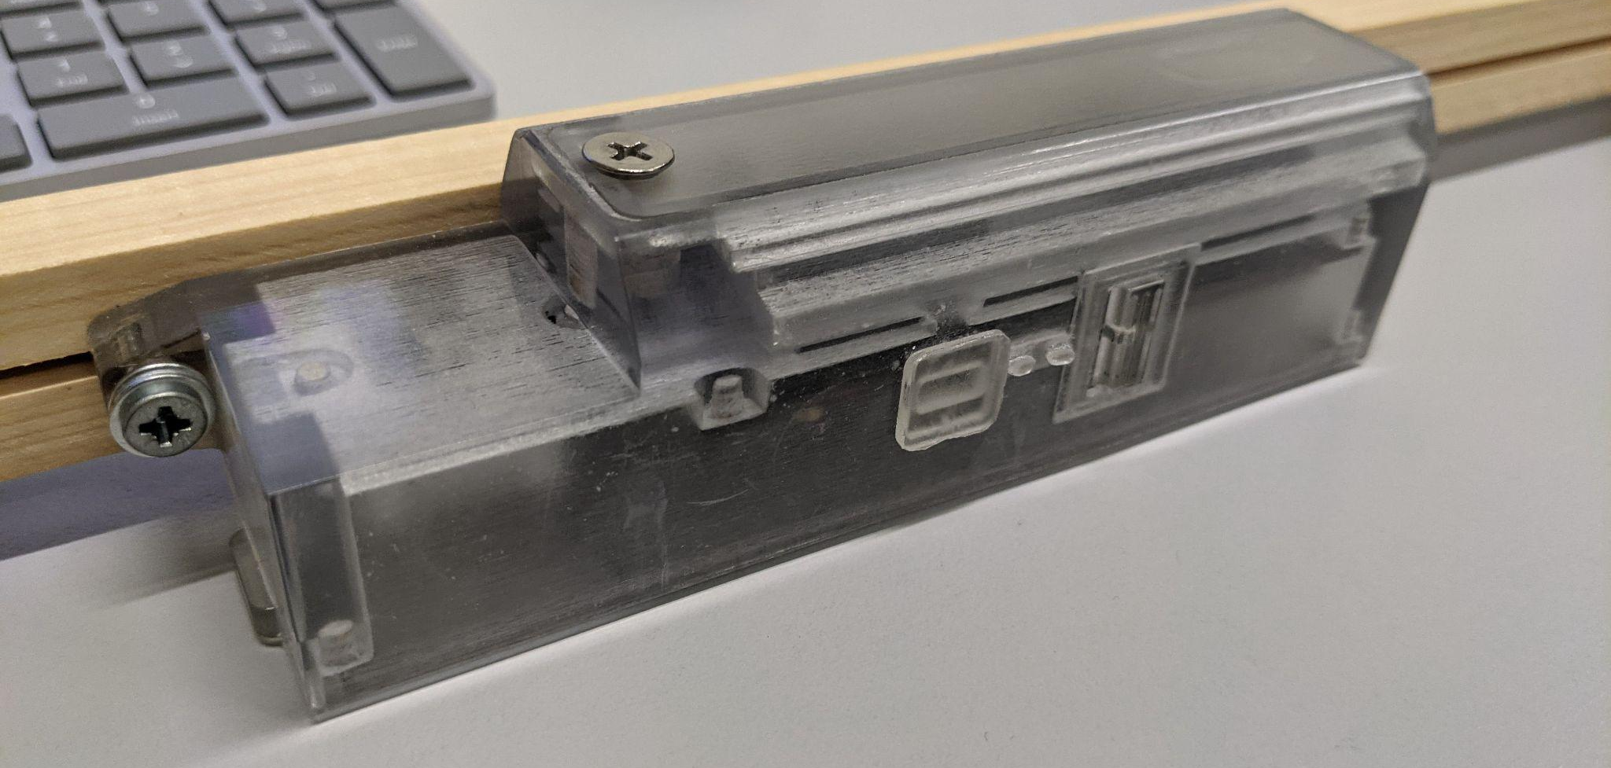
Systems prototyping

Slide 26
Repository with 3D printable assets (~40 assets)

Slide 27
Example of 3D printable assets

Slide 28
Other activities

Slide 29
Next steps
Create open datasets
Create Data API for researchers
Wearable implementation and evaluation
More inspection scenarios
LoRaWAN on Helium
Use GIS technology (e.g. blossom areas)
BeeXML - Exchange data about bees and beekeeping
Create an open testbed and community

Slide 30
These were only a few examples on how technology can help for sustainable beekeeping.
Beekeeping has long history and carries a rich cultural heritage.
By a multidisciplinary approach, let’s discover the most important “worker” of nature, the bee!

Slide 31
Thank you!
v.nomikos@aegean.gr

Slide 32
Links
https://myhive.aegean.gr/
https://iohive.aegean.gr/
https://www.syros.aegean.gr/el
https://www.facebook.com/DPSDE
https://www.facebook.com/isd.aegean
https://www.facebook.com/IOHive
https://www.youtube.com/@iohive1426
https://www.un.org/en/observances/bee-day
https://www.youtube.com/watch?v=el-Z5tgyQXY
https://www.thethingsnetwork.org/
https://github.com/beepnl/BEEP

